Slide 1
第二章 太阳观测方法

Slide 2
内容提要
2-1 地面光学观测中的视宁度
2-2 太阳照像仪和白光高分辨率观测
2-3 色球望远镜和双折射滤光器
2-4 大型望远镜的成像系统
2-5 速度和磁场测量
2-6 空间太阳观测

Slide 3
2-1 地面光学观测中的视宁度

Slide 4
视宁度——大气湍流造成的望远镜焦平面上太阳像或星像的毁坏程度，是衡量观测地天文气候优劣的标准。
起源：太阳辐射产生的空气对流引起湍流，导致太阳光路上的大气温度和密度起伏，亦即折射率的起伏，使太阳像的质量毁坏。

Slide 5
湍流的三种影响：
(a) 大尺度湍流
整体清晰锐利但不停抖动.
(b) 中尺度湍流
局部清晰但不同区域相对运动.
(c) 小尺度湍流
太阳像整体模糊.

Slide 6
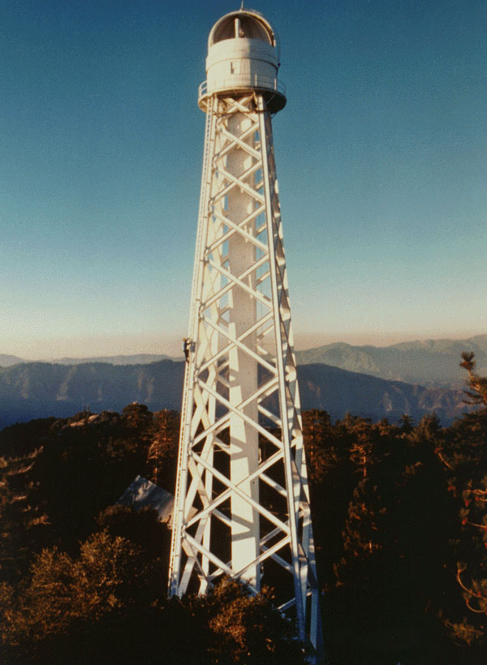
湍流影响的消除方法
选址在高山或湖面上
望远镜建在塔中
望远镜光路抽真空或充氮
采用自适应补偿校正技术
图像还原技术

Slide 7
2-2 太阳照像仪和白光
高分辨率观测

Slide 8
太阳照像仪(heliograph)
太阳的跟踪
太阳光
地 球
观测光谱：白光

Slide 9
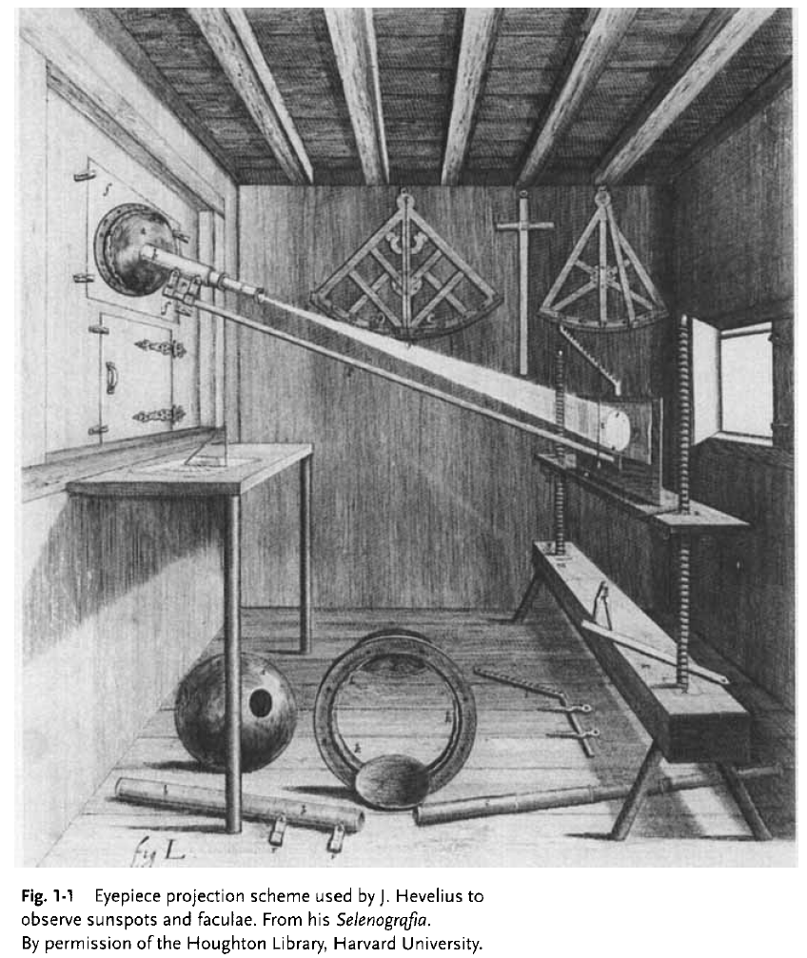

Slide 10
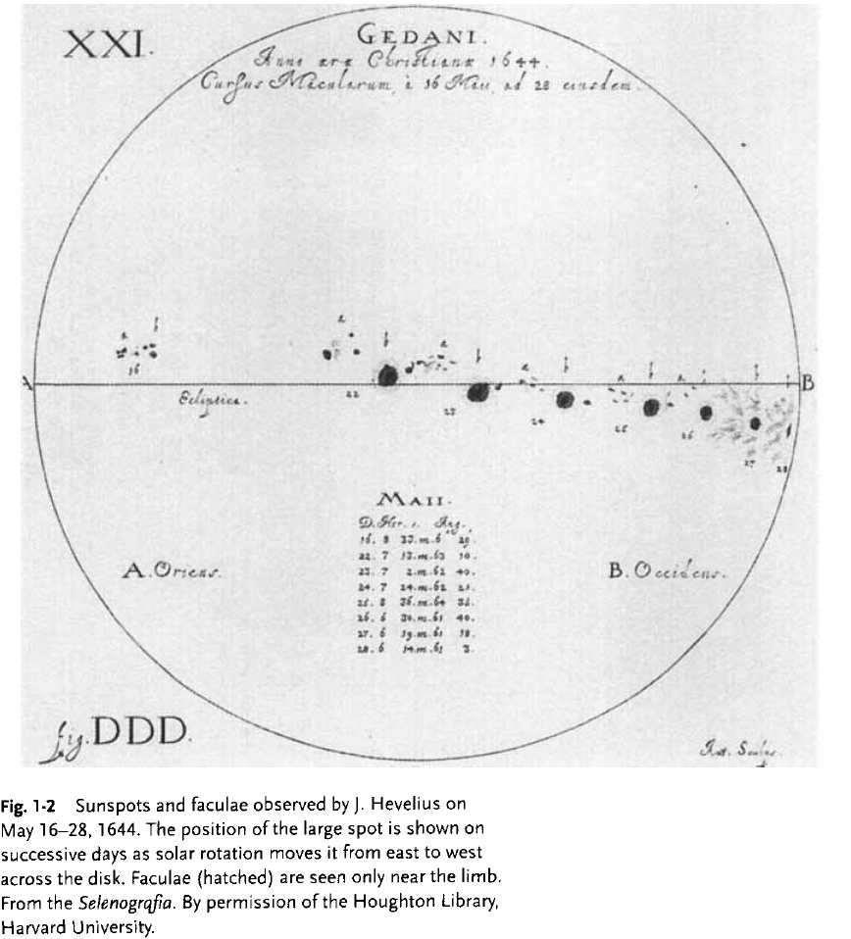

Slide 11
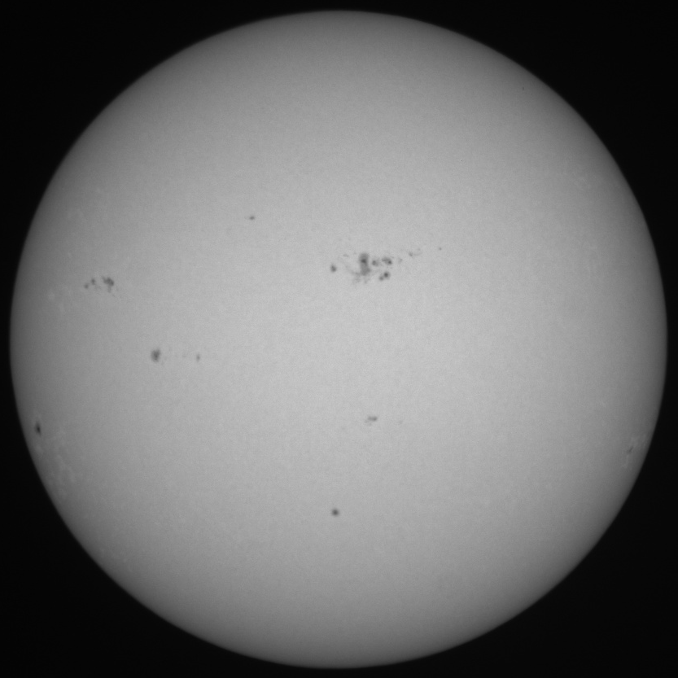
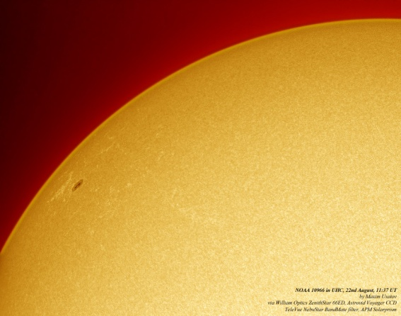
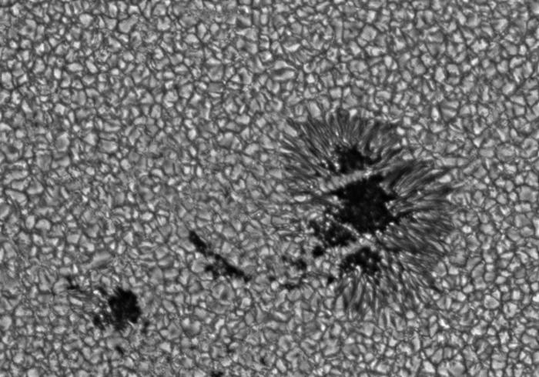
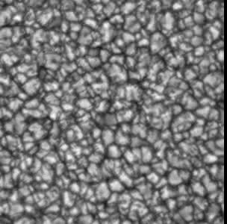
可观测到的现象
黑子和米粒
光斑
黑子
光斑

Slide 12


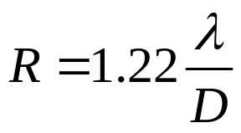

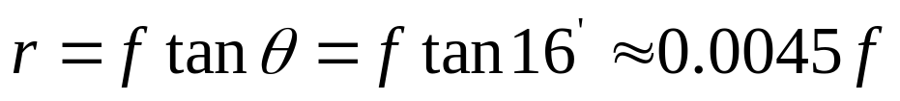
仪器参数
物镜口径: D=10~30 cm
空间分辨率
焦距 f : 确定太阳像大小
图像接受:
a、照相机；b、CCD；c、投影屏
思考题：如果用一像素为1024×1024的CCD拍摄太阳的全日面像，取观测波长为5000Å，请问最小要用多大口径的望远镜才能获得最佳的空间分辨率？

Slide 13
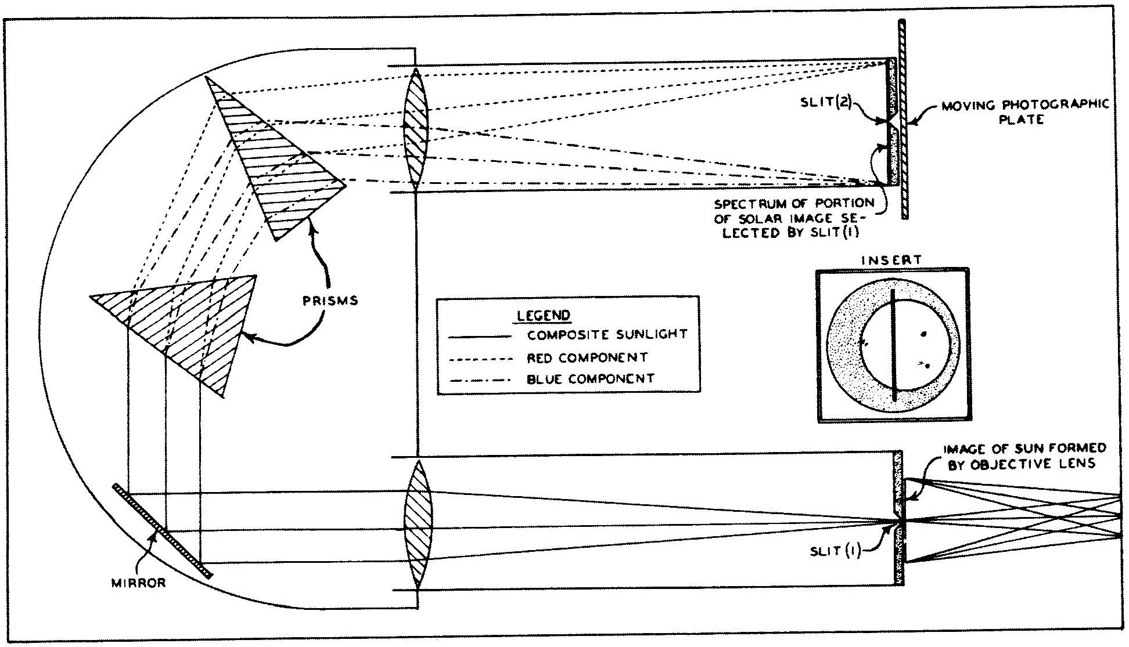
光谱成像观测原理：出射狭缝对准光栅的某一条谱线，将入射狭缝在太阳表面移动扫描，同时保持照相板的同步移动。
(George Ellery Hale; Henri-Alexandre Deslandres最先采用这种技术对太阳大气进行光谱成像观测)

Slide 14
2-3 色球望远镜和双折射滤光器

Slide 15
1、概况
色球望远镜（Chromospheric Telescope)—在光路中附加有透过波长在色球发射谱线处，透过波宽非常窄的滤光器的望远镜。
可以在某一谱线处对太阳一定区域，进行同时成像观测，不需要利用狭缝进行扫描成像。
常用谱线：H_{α}(6562.8Å), H_{β}(4861.3Å), Ca II K(3933.7Å)
光学系统：
a b c d e f g
a 物镜; b 宽波段滤光片; c 第一焦平面; d 准直镜; e 双折射滤光器; f 成像镜; g 第二焦平面.

Slide 16
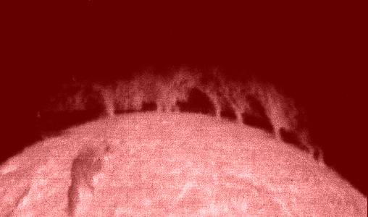
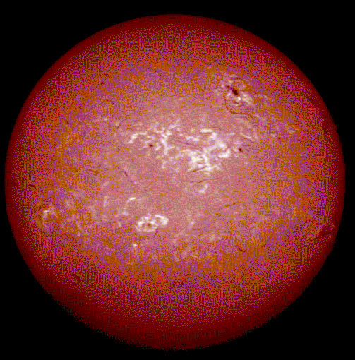

观测的现象
日珥或暗条
谱斑
暗条
耀斑

Slide 17
2、双折射滤光器的原理
构造
b₁ b₂ b₃
P: 偏振轴相互平行的偏振片
b: 双折射晶体，光轴一致且平行于晶体表面，同时与偏振片成45度夹角。每级厚度是前一级的两倍。
P₁ P₂ P₃ P₄
又称为Lyot （利奥）滤光器，由法国科学家Bernard Lyot于1933年发明。Lyot还于1930年设计、建造了第一台能工作的日冕仪。

Slide 18
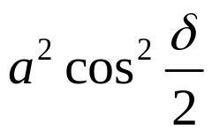
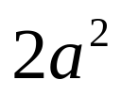


干涉光强
第一干涉级(P₁b₁P₂)之后
P₁
b₁
P₂
自然光
偏振光
o 光
e 光
干涉偏振光

Slide 19
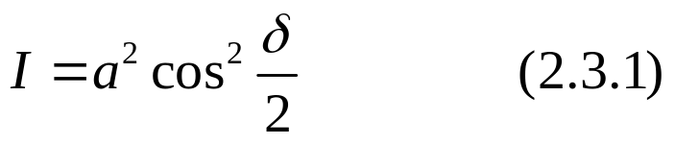
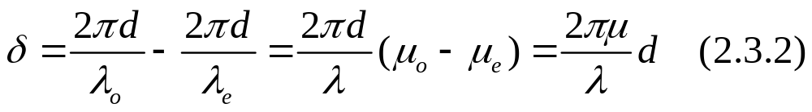


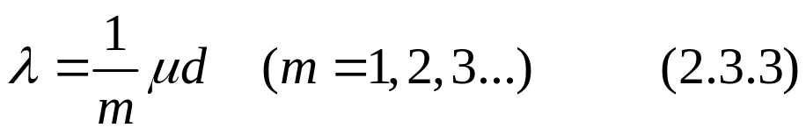


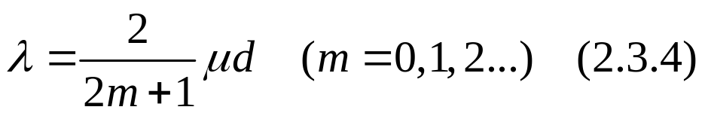
干涉光强：
极大强度： ，光程差 即
极小强度： ，光程差 即

Slide 20
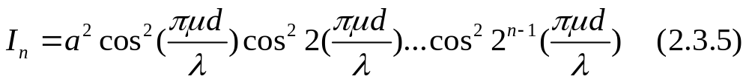
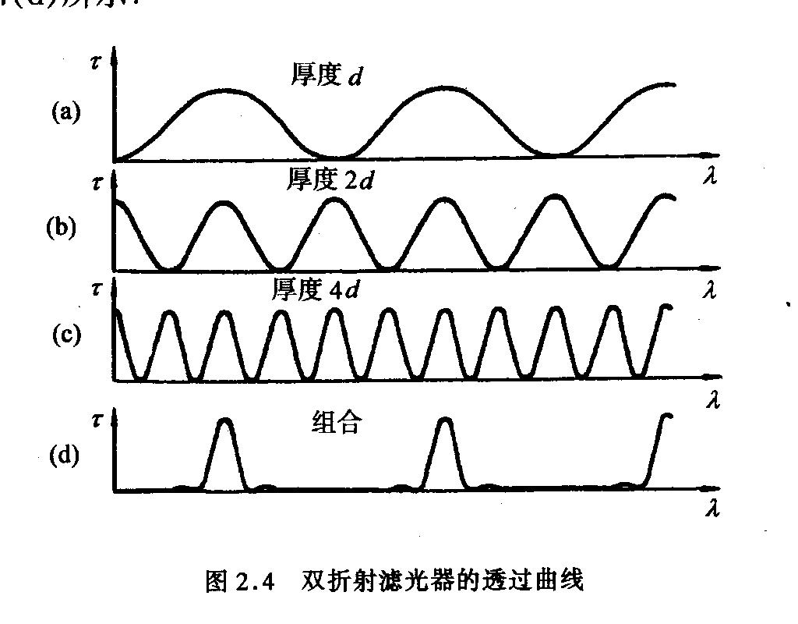
多极干涉之后的光强
第一块厚度：决定锐带的间距；级数 ：决定锐带本身宽度
通过调节双折射晶体的温度，可以让透过波长在谱线的线翼和线心之间移动, 观测不同高度大气的辐射。

Slide 21
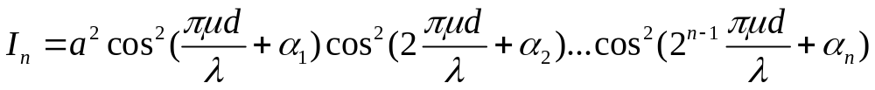
多波段双折射滤光器
b₁ b₂ b₃
W: 1/4波片，双折射晶体，其光轴与表面平行且与它前面的晶体光轴成45°。其作用是使o光和e光的程差正好等于1/4波长。
P₁ W P₂ W P₃ W P₄
若使1/4波片后的偏振片转动α角，则出射光强度分布为：
通过调整α使透过的中心波长发生移动。

Slide 22
2-4 大型望远镜的成像系统

Slide 23
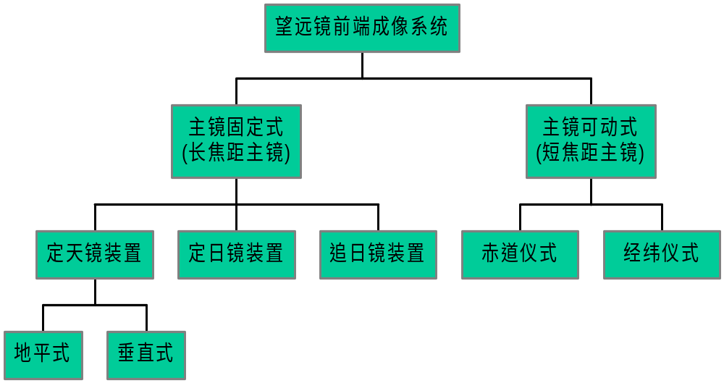
基本类型

Slide 24
1、地平式定天镜装置
S
P₄
P₃
P₂
O
P₁
P 为平面镜, 其中P1和P2构成定天镜, O为主镜, S为入射狭缝。

Slide 25
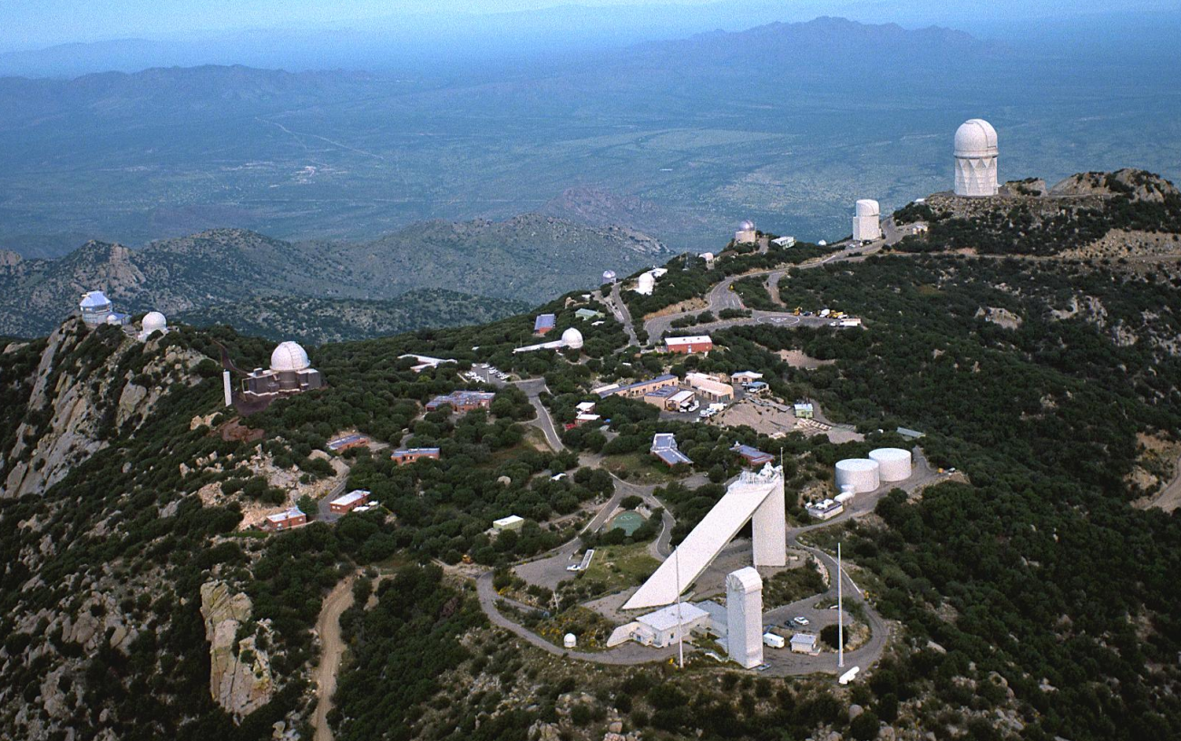
2、垂直式（塔式）定天镜装置
P₂
P₁
P₃
S
P₄
O
美国Kitt峰天文台

Slide 26
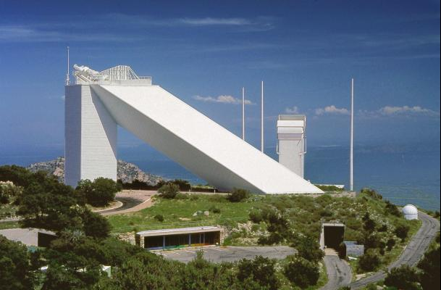
3、定日镜装置
P₁
P₂
O
S
P1为定日镜，将太阳光沿极轴方向直接反射到物镜。

Slide 27
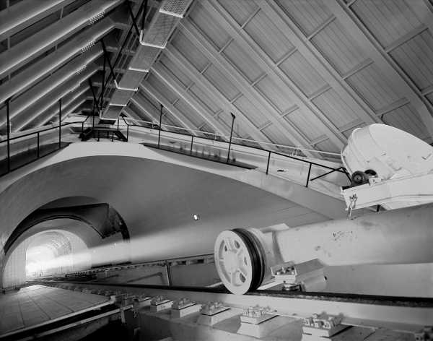
定日镜口径2.08 m, 离地高度34m，主镜口径1.5m，焦距92m.

Slide 28
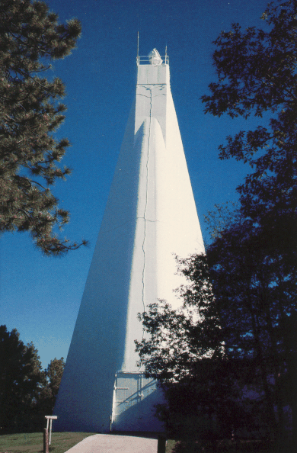
4、追日镜装置
W
P₂
P₁
W为密封窗，W 、P1和P2一起可绕通过P2的垂直轴转动，W和P1一起可绕水平轴转动而对准太阳。类似经纬仪。
美国Sacramento峰天文台真空太阳塔 (高度41m)

Slide 29
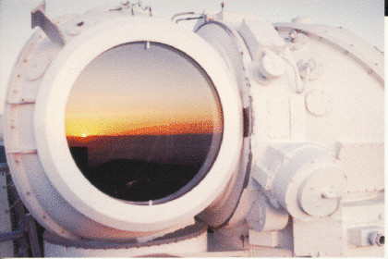
追日镜口径1.1m，主镜直径1.2m，太阳像直径51cm，整个光路由直径1.2m的圆筒封装后抽真空。

Slide 30
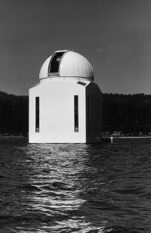
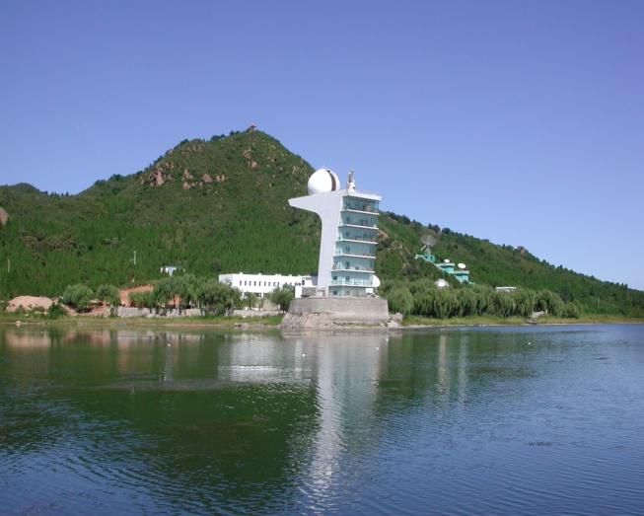
5、赤道仪式装置
主镜安装在望远镜筒上，可绕极轴和赤纬轴转动而对准太阳，并随极轴转动而跟踪太阳。
北京天文台怀柔太阳观测台
美国Big Bear太阳观测台

Slide 31
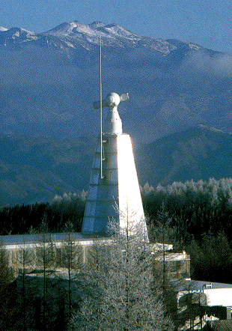
6、经纬仪式装置
望远镜绕垂直轴和水平轴指向太阳，由计算机控制绕垂直轴和水平轴同时旋转来跟踪太阳。
日本Hida天文台60cm望远镜

Slide 32
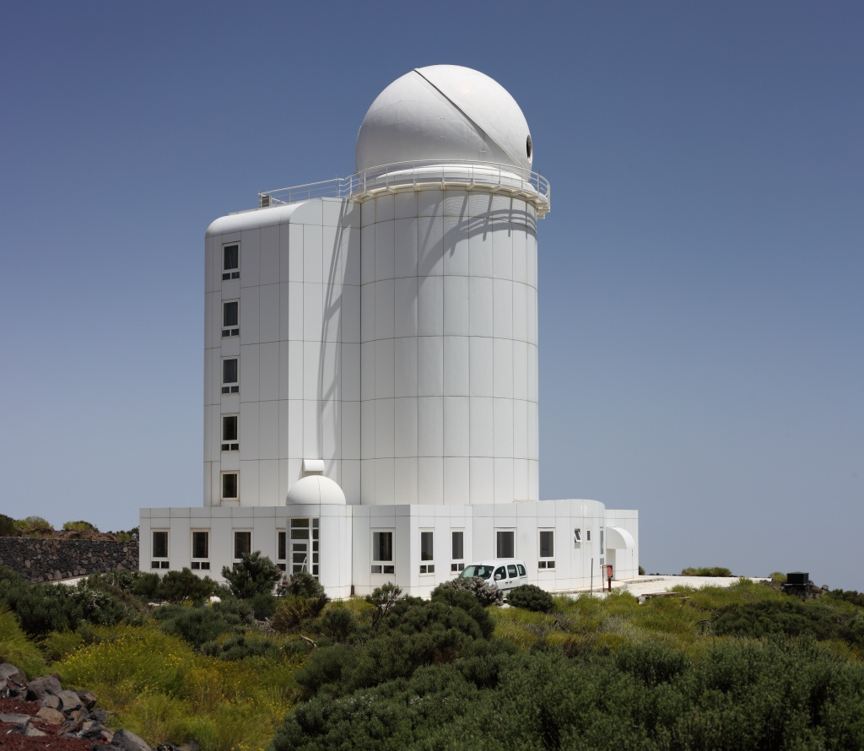
THEMIS (Heliographic Telescope for the Study of the Magnetism and Instabilities on the Sun) 巨型太阳望远镜(法国/意大利)

Slide 33
2-5 速度和磁场的测量

Slide 34
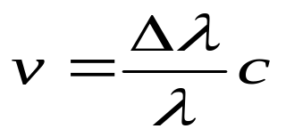




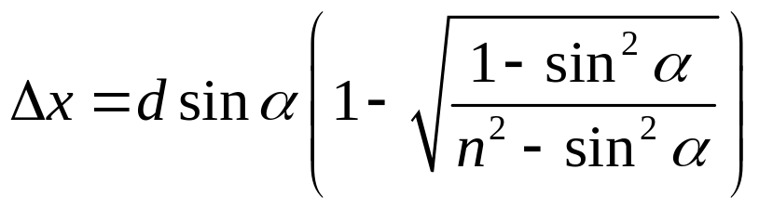

速度的测量: Doppler 效应
测量精度：1~10m/s
Doppler 补偿器原理。红线：存在Doppler位移的谱线轮廓；实线：波片旋转α角后的谱线轮廓。

Slide 35
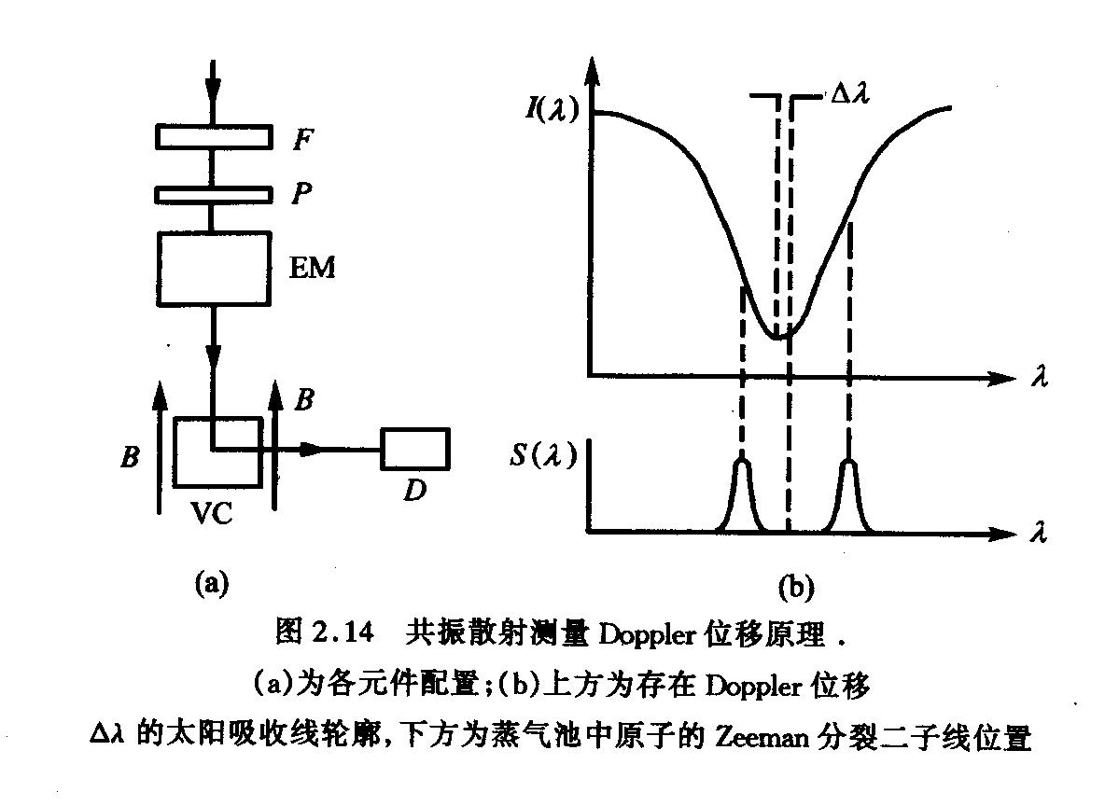
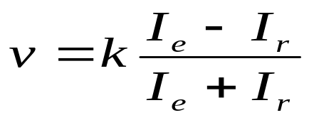
窄带滤光片
偏振片
电光调制器
蒸汽池
光电管
电光调制器：使o光和e光的相位差在±λ/4之间变化，从而使出射光束交替成为左旋和右旋偏振光。
测量精度：1cm/s

Slide 36




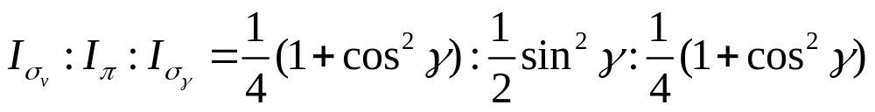
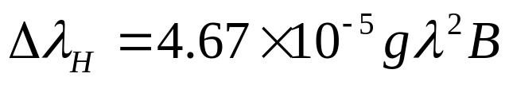
1、纯发射线的Zeeman分裂
磁场的测量：Zeeman分裂
左旋
右旋
γ为观测方向与磁场夹角

Slide 37
2、纯吸收线的Zeeman分裂
右旋
左旋
部分线偏振光
部分线偏振光
(a) 纵向观测
(b) 横向观测
太阳光谱中的谱线，既非纯发射线，也非纯吸收线。严格地，需要建立求解谱线的Stokes转移方程。

Slide 38
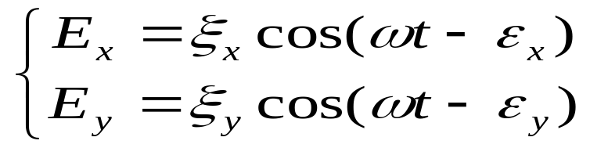
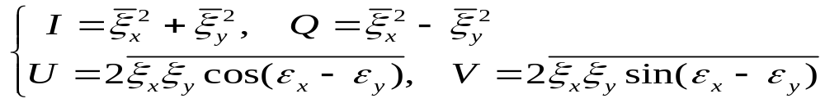
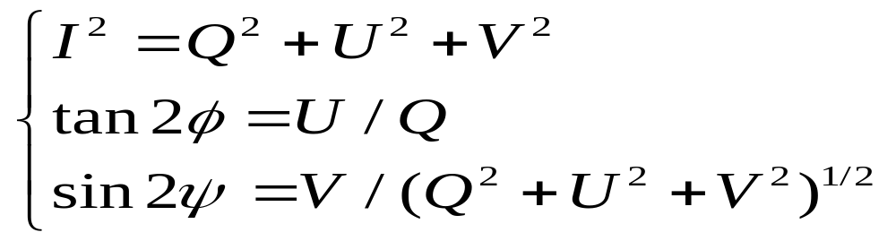
3、偏振光的Stokes 参数
假设光传播方向为 z 向，电场振动矢量在 xy 平面，为
四个Stokes参数定义为
且
其中  为椭圆偏振光的椭圆长轴和 x 轴的夹角，而  为椭圆短轴和长轴之比，  < 0 和  > 0分别表示左旋和右旋偏振。

Slide 39
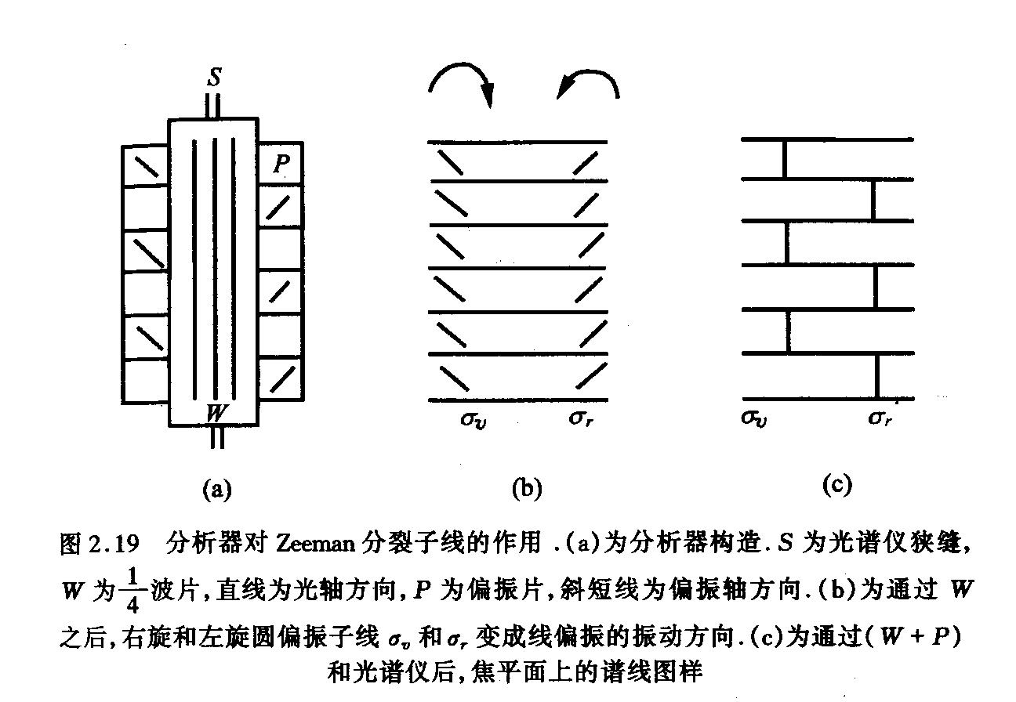
4、强磁场的测量
通过直接测量分裂子线的裂距，测量磁场强度。Hale & Nicholson于20世纪初最早对黑子的磁场强度和极性进行了系统观测和分析, 得到太阳磁场演化的22年周期，这也是人类第一次证实在地球外的星体中存在磁场.

Slide 40
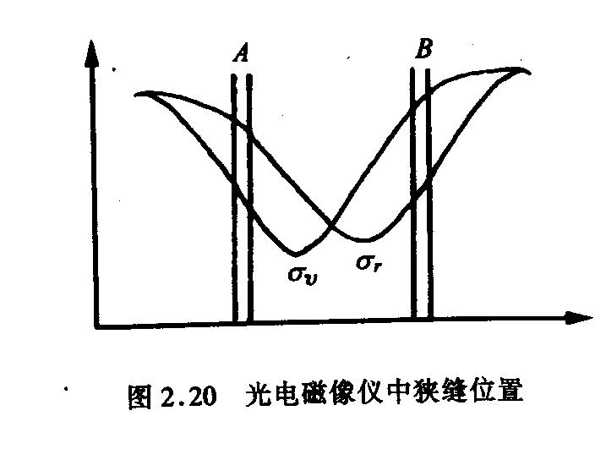
5、弱磁场的测量——光电磁像仪
对弱的磁场, 只能采用光电管分别接收两条分裂谱线的强度。
两条分裂线交替消失的方法：
光谱仪狭缝前的1/4波片和偏振片之间加一旋转的1/2波片。
采用电光晶体ADP或KDP。
H.W.Babcock(1951)最早用该方法测量得到太阳极区磁场平均1-5Gs。
将光谱仪的入射狭缝在太阳像的某一区域进行扫描，可以得到该区域纵场的分布，称为纵场磁图。这种由光电调制的分析器、光谱仪、光电管和记录设备组成的装置就称为光电磁像仪(photoelectric magnetograph).
如果要测量三维的磁场，则需要测量谱线的完整偏振状态（四个Stokes参量），再通过求解磁场中谱线的Stokes辐射转移方程，反演得到。

Slide 41
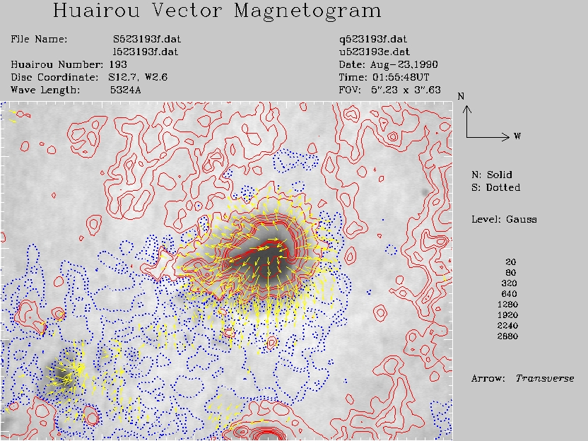
北京天文台怀柔观测站的观测磁图

Slide 42
2-6 空间太阳观测

Slide 43
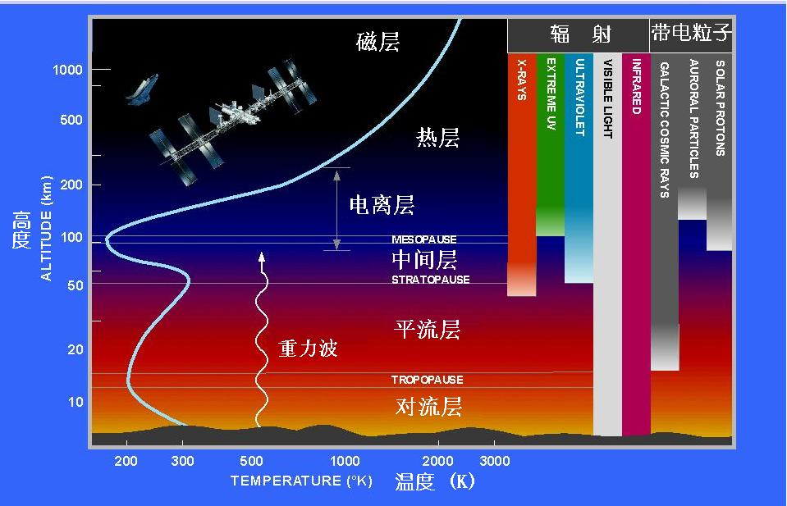
一、必要性
地球大气对太阳光的吸收。

Slide 44
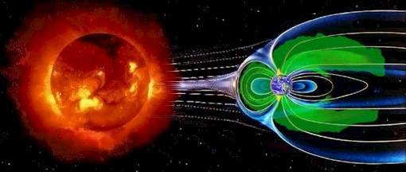
地球磁场对辐射粒子的屏蔽。

Slide 45
二、太阳观测历史事件
1610-13 | Galileo Galilei 首次用望远镜系统观测黑子。
1733 | Jean Jacques d’Ortous de Mairan 认为极光和黑子有联系。
1802-15 | 1802年W. H. Wollaston 发现太阳吸收线，1815年J. von Fraunhofer证认出300余条吸收线
1844 | S. H. Schwabe 发现黑子变化的11年周期。
1858 | R. C. Carrington发现黑子位置从高纬到低纬的纬度迁移规律
1859-60 | R. C. Carrington和R. Hodgson首次发现白光耀斑
1868 | 对1868-8-16的日全食观测，发现“氦”的黄色谱线(1895年证认)
1889-90 | F. H. Bigelow提出观测到的日冕结构由大尺度磁场控制的观点
1908 | G. E. Hale测量得到黑子的磁场有数千高斯
1919 | G. E. Hale及其同事得到黑子磁场变化的22年周期

Slide 46
1928-32 | A. Unsold, W. H. Mc Crea等发现氢是太阳大气中最丰富的元素
1939-41 | W. Grotrian和B. Edlen证认日冕发射线为高电离级次谱线，表明日冕温度为百万度。
1946 | V. L. Ginzburg, D. F. Martyn, J. L. Pawsey独立由射电观测结果确认日冕温度为百万度。
1946 | R. Tousey及其同事利用美国V-2火箭得到第一张太阳极紫外照片
1948-49 | 1948-8-5，美国V-2火箭得到第一张太阳软X射线照片
1951-52 | H. Friedman及其同事证实太阳软X线和紫外线的辐射强度足以产生电离层
1951-57 | L. F. Biermann由彗尾的观测，提出行星际存在速度达500-1000km/s的太阳风
1955 | L. Davis Jr.提出日球层的存在
1957 | 1957-10-4，第一颗人造卫星发射
1958 | E. N. Parker提出太阳风的理论模型

Slide 47
1958-59 | 1958-2-1美国第一颗人造卫星Explorer 1发射，A. Van Allen和其同事发现地球辐射带
1960-61 | K. I. Gringauz利用苏联卫星Lunik 2观测证实太阳风的存在
1964-66 | 1963-11-27，IMP1发射，发现行星际螺旋、扇形磁场
1973 | A. S. Krieger等证实冕洞是高速太阳风的源
1973 | G. S. Vaiana及其同事利用火箭拍摄的软X像，发现日冕结构的三成分：冕洞、冕环、X射线亮点
1973-77 | Skylab卫星，及IMP6, 7 , 8系列卫星发射
1974-86 | Helios 1、2发射，测量接近0.3AU处的太阳风参数的11周年变化
1978 | E. J. Smith、B. T. Tsurutani 和 R. L. Rosenberg 利用Pioneer 11卫星发现在纬度16度以上，太阳风磁场为单极场
1980- | SMM、Yohkoh、Ulysses、SOHO、TRACE、Hinode、STEREO、SDO等卫星相继发射

Slide 48
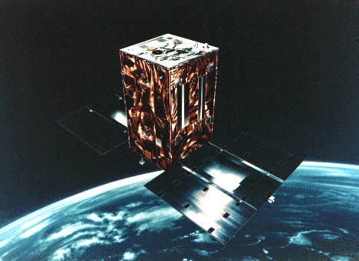
主要卫星——Yohkoh
Yohkoh卫星，1991年8月发射，日本，太阳软X射线和硬X射线观测卫星。

Slide 49
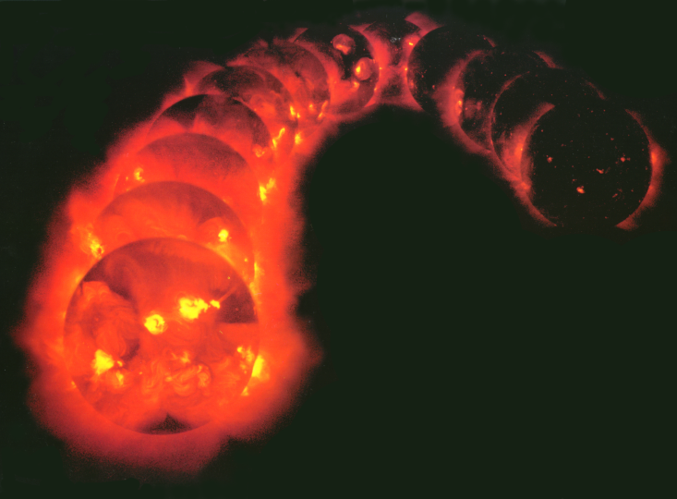
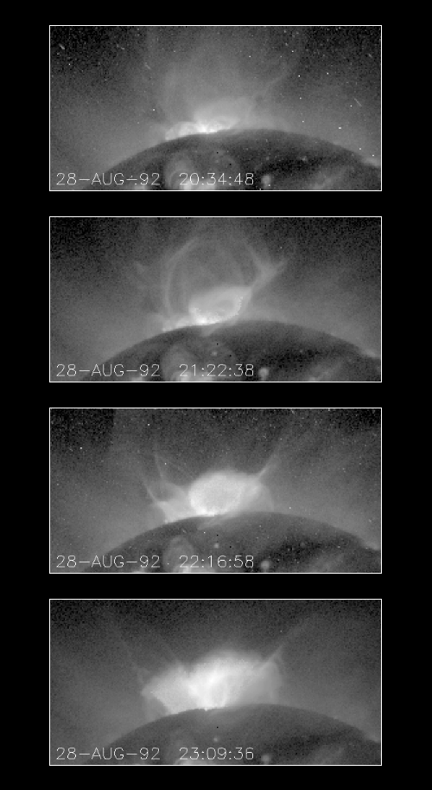
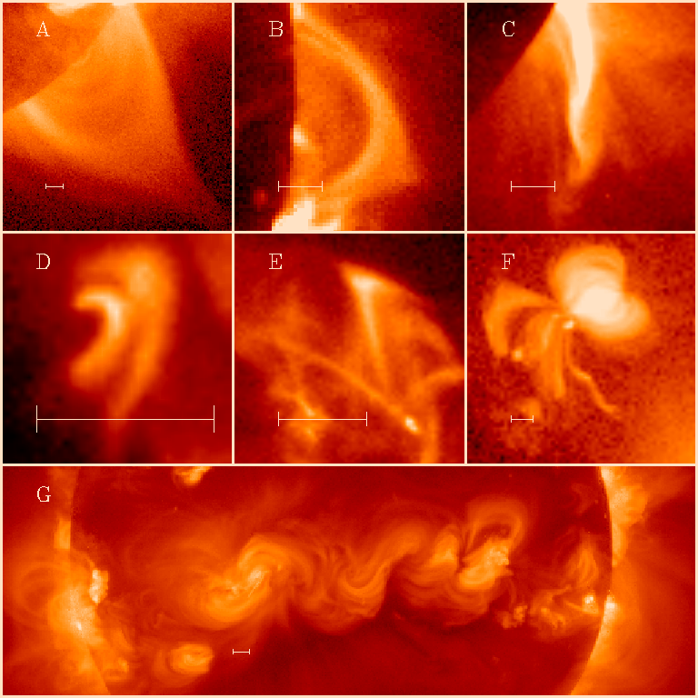

Slide 50
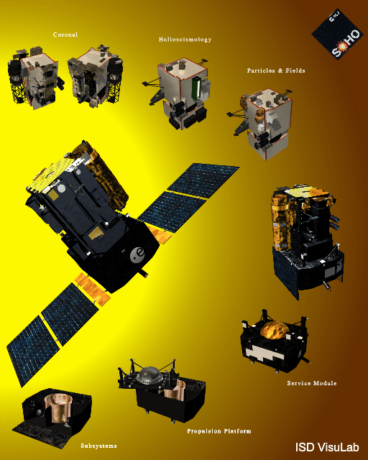
主要卫星——SOHO
SOHO (Solar & Heliospheric Observatory ) 卫星，1995年12月发射，ESA & NASA, 太阳和太阳风观测卫星.

Slide 51





Slide 52



主要卫星——Ulysses
ULYSSES卫星，1990年10月发射，ESA & NASA, 高纬日球层观测卫星。

Slide 53



Slide 54

主要卫星——TRACE
TRACE (Transition Region And Coronal Explorer) 卫星，1998年4月发射，NASA, 太阳过渡层观测卫星。

Slide 55




Slide 56


主要卫星——Hinode (Solar-B)
Hinode (Solar-B)卫星，2006年9月发射，日本，高分辨率的太阳磁场、过渡区和日冕观测卫星。

Slide 57
设备：
The Solar Optical Telescope (SOT) will obtain measurements of the magnetic field with a spatial resolution of 0.2 arcseconds and will become the first telescope in space to measure the Sun's three-dimensional magnetic field vector.
The Extreme Ultraviolet Imaging Spectrometer (EIS) has a total length of 3 meters. EIS will obtain high-cadence, monochromatic images of the transition region and corona of the Sun.
Solar X-ray Telescope (SXT) for Solar-B. Similar to the X-ray telescope of Yohkoh, the new SXT will have significant improvements in spatial resolution and temperature response. The focal length of the telescope will be 2.7 meters and when combined with imaging electronics, will yield a resolution of 1.0 arcsec.

Slide 58


Slide 59

Hinode观测的网络场磁图

Slide 60

The main sunspot in NOAA Active Region 11692 is shown in this movie from March 17, 2013. Electrically charged material of different temperatures flows along channels defined by magnetic fields in the penumbra, or outer part of the sunspot. The brighter material is warmer and the darker flows are cooler than the surrounding material. In the dark umbra, central to the sunspot, structures are cool enough to be hidden at the emission temperature of the CN molecular band captured by Hinode's SOT in this movie. Just to the northwest of the main sunspot, we see a "bubble" grow as magnetic field upwells the solar surface. Near circular solar granulation cells become elongated and inter-granular material is squeezed and heated forming small bright points. Along the edges of the bubble, the magnetic field pressure suppresses heating, and pores, smaller versions of the sunspot umbra, begin to take shape.

Slide 61

The current solar cycle, the 24th since sunspot monitoring began in earnest around 1755, has peaked and is moving into its declining phase. An image for every year is displayed above, starting in 2008, which heralded the new cycle with the appearance of the first reversed-polarity sunspot. This cycle is notable for having the lowest activity levels since the dawn of the space age and the lowest sunspot counts in a century.

Slide 62


主要卫星——STEREO
STEREO卫星，2006年10月发射，人类首次利用两颗卫星对太阳的立体观测。

Slide 63

This graphic illustrates how a combination of spacecraft have the Sun well covered. From their positions near the Sun-Earth line, SDO and SOHO observed this small CME (coronal mass ejection) on July 4, 2013. At the same time, both the STEREO Ahead and Behind spacecraft watched the eruption as well. The size, direction, speed, and velocity can all be determined when we have multiple points of view. Other instruments on these spacecraft capture a lot of additional information about solar activity as well. And we will have this 360-degree capability for years to come.

Slide 64

Sun Earth Connection Coronal and Heliospheric Investigation (SECCHI)：Comprised of four instruments: an extreme ultraviolet imager, two white-light coronagraphs and a heliospheric imager. These instruments study the 3-D evolution of CME's from birth at the Sun's surface through the corona and interplanetary medium to its eventual impact at Earth.

Slide 65

Solar Activity in August 2010 seen by all the STEREO SECCHI suite's imaging telescopes. The top row shows (left to right) image from HI2 and HI1 from STEREO B; EUVI, Cor1, and Cor2 from STEREO A; and HI1 and HI2 from STEREO A. The bottom row only shows images from EUVI and the two coronagraphs (Cor1 and Cor2) for STEREO B (left) and STEREO A (right).

Slide 66

STEREO/WAVES (SWAVES)： SWAVES is an interplanetary radio burst tracker that traces the generation and evolution of traveling radio disturbances from the Sun to the orbit of Earth.

Slide 67

In-situ Measurements of Particles and CME Transients (IMPACT)： IMPACT sample the 3-D distribution and provide plasma characteristics of solar energetic particles and the local vector magnetic field.

Slide 68

Plasma and SupraThermal Ion Composition (PLASTIC)： PLASTIC provide plasma characteristics of protons, alpha particles and heavy ions. This experiment will provide key diagnostic measurements of the form of mass and charge state composition of heavy ions and characterize the CME plasma from ambient coronal plasma.

Slide 69

The STEREO (Ahead) spacecraft recently caught an erupting prominence that demonstrates the convoluted physics of magnetic reconnection (May 21-22, 2008). In the beginning of the video clip prominence material is ejected up and away from the Sun's surface. The remaining plasma (ionized gas) of the prominence is being pulled in several directions by powerful magnetic forces from an active region. It appears to spin counter-clockwise then clockwise over a period of a few hours.

Slide 70

This STEREO image and video clip of the Sun in extreme ultraviolet light (June 9-10, 2007) showcases a string of active regions near the Sun's equator over about 36 hours. We see several active regions (brighter areas with the loops above them) that were lined up as they approached the edge of the Sun. With frames being taken every two and a half minutes, scientists can observe the activity along these magnetic field lines in exquisite detail. Active regions are areas of intense magnetic activity that appear brighter in extreme UV light, in this case the wavelength of 171 Angstroms. The images were captured by the Behind spacecraft.

Slide 71

The Sun blasted out two coronal mass ejections (CMEs) and a flare on March 25, 2008. STEREO's COR 2 coronagraph (Ahead) caught the action. In the video clip, a smaller CME first bursts off to the right. After an 8-hour data gap, a flare and associated CME blast off to the left in a much larger bulbous cloud of particles. The flare, a moderate M-class event, is the largest STEREO has seen this year.

Slide 72

There was a transit of the Moon across the face of the Sun - but it could not be seen from Earth. This sight was visible only from the STEREO-B spacecraft in its orbit about the sun, trailing behind the Earth. NASA's STEREO mission consists of two spacecraft launched in October, 2006 to study solar storms. The transit starts at 1:56 am EST and continued for 12 hours until 1:57 pm EST. STEREO-B is currently about 1 million miles from the Earth, 4.4 times farther away from the Moon than we are on Earth. As the result, the Moon will appear 4.4 times smaller than what we are used to.

Slide 73


NASA's STEREO satellite captured the first images ever of a collision between a solar "hurricane", called a coronal mass ejection (CME), and a comet. The collision caused the complete detachment of the comet's plasma tail. Comets are icy leftovers from the solar system's formation billions of years ago. They usually hang out in the cold, distant regions of the solar system, but occasionally a gravitational tug from a planet, another comet, or even a nearby star sends them into the inner solar system. Once there, the sun's heat and radiation vaporizes gas and dust from the comet, forming its tail. Comets typically have two tails, one made of dust and a fainter one made of electrically conducting gas, called plasma。

Slide 74

主要卫星—SDO, Solar Dynamic Observatory
SDO卫星，2010年2月发射。对太阳的极紫外辐射、太阳表面矢量磁场、振动速度场进行高时间和空间分辨率的观测，研究太阳的动力学过程。

Slide 75

HMI (Helioseismic and Magnetic Imager) HMI extends the capabilities of the SOHO/MDI instrument with continual full-disk coverage at higher spatial resolution and new vector magnetogram capabilities.

Slide 76

AIA (Atmospheric Imaging Assembly) AIA images the solar atmosphere in multiple wavelengths to link changes in the surface to interior changes. Data includes images of the Sun in 10 wavelengths every 10 seconds.

Slide 77

EVE (Extreme Ultraviolet Variablity Experiment) EVE measures the solar extreme-ultraviolet (EUV) irradiance with unprecedented spectral resolution, temporal cadence, and precision. EVE measures the solar extreme ultraviolet (EUV) spectral irradiance to understand variations on the timescales which influence Earth's climate and near-Earth space.

Slide 78

Image Resolution Comparison
The above image illustrates the resolution capabilities of the SDO, STEREO, and SOHO spacecrafts. SDO's AIA instrument (right image) has twice the image resolution than STEREO (middle image) and 4 times greater imaging resolution than SOHO (left image). The image cadence also varies. SDO takes 1 image every second. At best STEREO takes 1 image every 3 minutes and SOHO takes 1 image every 12 minutes.

Slide 79

太阳大气中的龙卷风

Slide 80



太阳大气中的龙卷风

Slide 81

SDO/AIA观测的一次抛射和冕雨

Slide 82

SDO/AIA观测的一次抛射和耀斑

Slide 83

主要卫星—IRIS, Interface Region Imaging Spectrograph
IRIS卫星，2013年6月发射。对太阳色球和过渡区进行高时空（1s, 1/3 arcsec）分辨率的紫外成像观测。研究色球和日冕间能量和物质的输运、耗散过程及其与太阳活动爆发的关系等。

Slide 84

The IRIS instrument is a multi-channel imaging spectrograph with a 20 cm UV telescope. IRIS will obtain spectra along a slit (1/3 arcsec wide), and slit-jaw images. The CCD detectors will have 1/6 arcsec pixels. IRIS will have an effective spatial resolution between 0.33 and 0.4 arcsec and a maximum field of view of 120 arcsec.
The far-UV channel covers: 1332-1358 Å and 1390-1406 Å with 40 m Å resolution and an effective area of 2.8 cm2. The near-UV channel covers: 2785-2835 Å with 80 mÅ resolution and an effective area 0.3 cm2. Slit-jaw imaging will have four passbands: 1335 Å and 1400 Å with 40 Å bandpass each；2796 Å and 2831 Å with 4 Å bandpass each.

Slide 85

Comparison of Resolution Between SDO (left) and IRIS (right)

Slide 86

Comparison of Resolution Between SDO (left) and IRIS (right)

Slide 87

The fine detail in images of prominences in the sun's atmosphere from NASA's Interface Region Imaging Spectrometer – such as the red swirls shown here – are challenging the way scientists understand such events.

Slide 88

On Jan. 28, 2014, NASA's Interface Region Imaging Spectrograph, or IRIS, witnessed its strongest solar flare since it launched in the summer of 2013

Slide 89

主要卫星—RHESSI，Reuven Ramaty High Energy Solar Spectroscopic Imager
太阳高能粒子谱成像望远镜，2002年2月5日发射。

Slide 90

RHESSI is designed investigate particle acceleration and energy release in solar flares, through imaging and spectroscopy of hard X-ray/gamma-ray continua emitted by energetic electrons, and of gamma-ray lines produced by energetic ions.

Slide 91
RHESSI 对2011年1月28日00:46:20发生的M1.3级耀斑的观测。

Slide 92

主要卫星—Solar Probe Plus
太阳探针⁺ (Solar Probe Plus)卫星，计划2018年发射。
科学目标:
determine the structure and dynamics of the magnetic fields at the sources of solar wind;
trace the flow of energy that heats the corona and accelerates the solar wind;
determine what mechanisms accelerate and transport energetic particles;
explore dusty plasma near the Sun and its influence on solar wind and energetic particle formation.

Slide 93

计划发射时间: July 30, 2018;
飞过金星变轨 #1: Sept. 27, 2018; #2: Dec. 21, 2019; #3: July 5, 2020; #4: Feb. 15, 2021;
#5: Oct. 10, 2021; #6: Aug. 15, 2023; #7: Oct. 31, 2024.
第一次接近: Dec. 19, 2024. 轨道周期: 88天

Slide 94

Instruments will be retracted inside the umbra (shadow) of the Thermal Protection System to limit solar exposure.

Slide 95

主要卫星 — Solar Orbiter
计划2017年发射, 对太阳风和太阳进行实地和遥感测量。研究太阳风和日面磁场的起源, 太阳的发电机过程, 太阳瞬变事件对日球层的扰动, 高能粒子的起源和输运等。

Slide 96

Solar Orbiter‘s trajectory viewed from above the ecliptic (January 2017 launch). The gravity assist maneuvers (GAM) at Earth (E) and Venus (V) are indicated, along with the orbits of these two planets.
轨道离太阳最近0.28AU，相对太阳赤道最大倾角25-36度。

Slide 97


夸父计划将帮助科学家深入研究日地环境，将在很高的精度上追踪太阳爆发和地磁暴活动，为灾害性空间环境预报提供观测数据。同时，它将揭示日地空间风暴机理，监测行星际扰动传播。

Slide 98


空间太阳望远镜（Space Solar Telescope）期望于2018-2019年发射，运行寿命3年，望远镜口径一米，对太阳活动实行全波段和全连续观测，研究太阳活动区磁场变化、太阳耀斑的积蓄和爆发过程、日冕物质抛射、太阳风形成等多种太阳物理现象。

Slide 99


太阳极轨望远镜探测计划（Solar Polar Orbit Telescope, SPORT），国内第一次在太阳极轨的运行轨道上开展太阳观测和行星际探测，计划配置磁像仪、日冕仪、日球成像仪、太阳极紫外成像仪、高能粒子探测器、太阳风高能重离子成分探测器、太阳风等离子体探测器、磁强计、太阳射电爆探测器、等离子体波探测器等10台有效载荷。

Slide 100
一些网址
http://sohowww.nascom.nasa.gov
http://www.lmsal.com/SXT/homepage.html
http://ulysses.jpl.nasa.gov
http://helio.estec.esa.nl/ulysses/welcome.html
http://solarscience.msfc.nasa.gov/
http://trace.lmsal.com/
http://nssdc.gsfc.nasa.gov/solar/
http://nssdc.gsfc.nasa.gov/space/
http://solarb.msfc.nasa.gov
http://stereo.gsfc.nasa.gov/
http://sdo.gsfc.nasa.gov/
http://iris.gsfc.nasa.gov/
http://hesperia.gsfc.nasa.gov/rhessi2/
http://solarprobe.jhuapl.edu/index.php
http://www.solarorbiter.org/index.php

Slide 101
习题 2
如果用一像素为1024×1024的CCD拍摄太阳的全日面像，取观测波长为5000Å，请问最小要用多大口径的望远镜才能获得最佳的空间分辨率？
假设太阳望远镜物镜的口径为D，当望远镜的焦距f 为多长时，在焦平面上太阳像的辐射强度与地面自然太阳光的辐射强度相等？
假设Doppler补偿器中玻璃片的厚度为 d, 折射率为 n，证明谱线位移 Δx 和玻片旋转角度 α 之间的关系为

