Slide 1
Magnetospheric Dynamics

Slide 2
磁暴是地球的磁场的水平分量在 一到几个小时内急剧下降而在随后的几天内恢复。
A geomagnetic storm is characterized by a main phase during which the horizontal component of the Earth’s low latitude magnetic fields are significantly depressed over a time span of one to a few hours followed by its recovery which may extend over several days (Rostoker, 1997)”.
Measuring the variation of horizontal magnetic field Dst index: low latitude, hourly, global network

Slide 3
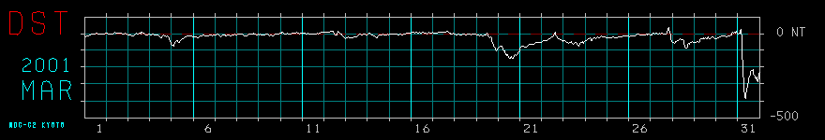
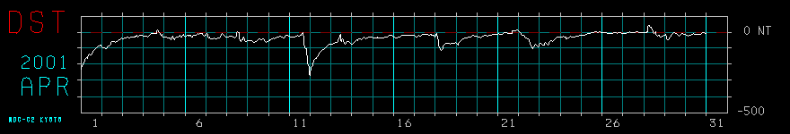
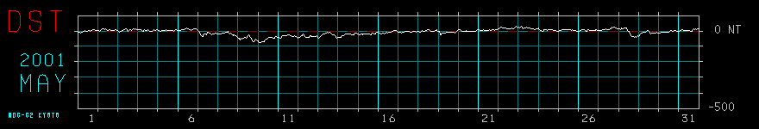
http://swdcdb.kugi.kyoto-u.ac.jp/

Slide 4
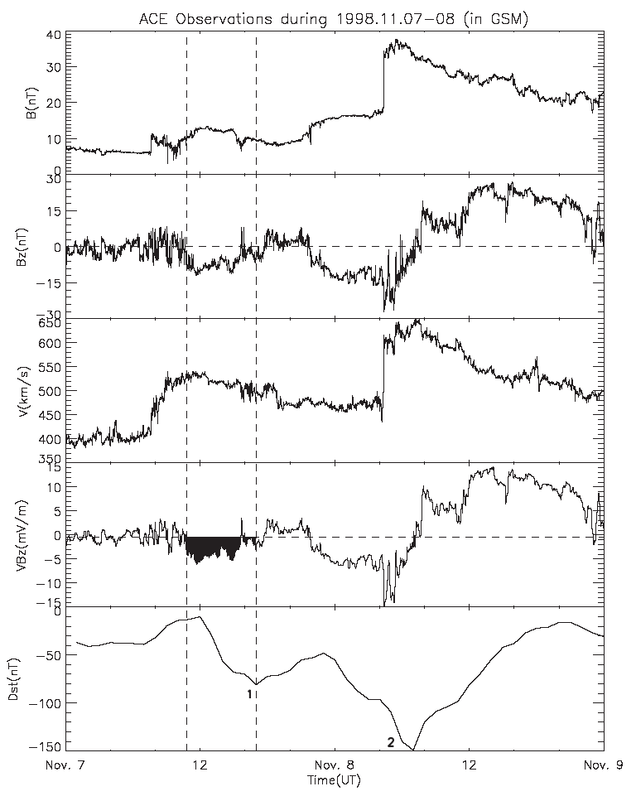
行星际参数
Dst 指数

Slide 5
Magnetic Storms
IMF is very strongly southward for an extended period…
…which drives very strong magnetospheric convection

Slide 6
Source of geomagnetic storms
磁云
CME
ejecta
地磁暴
激波
共转流相互作用区(CIR)
B_{s}, 磁场重联
[Tsurutani, 2000]

Slide 7
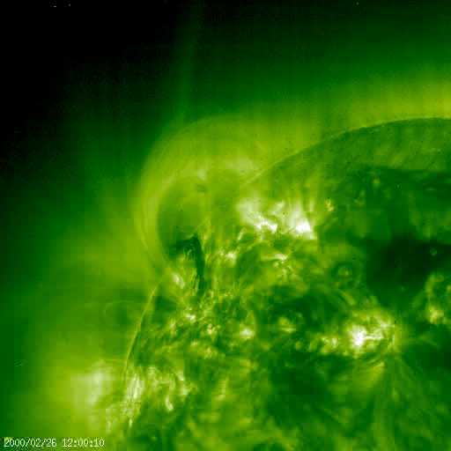
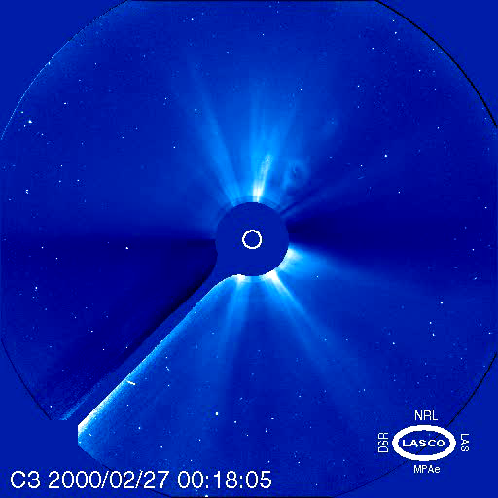
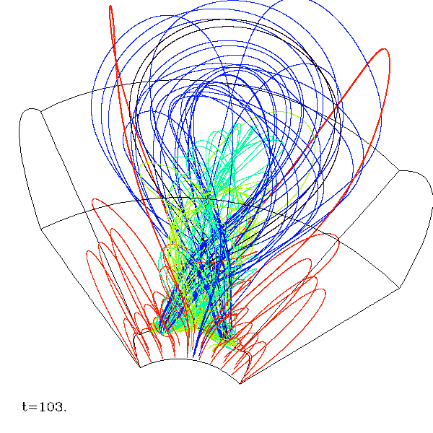
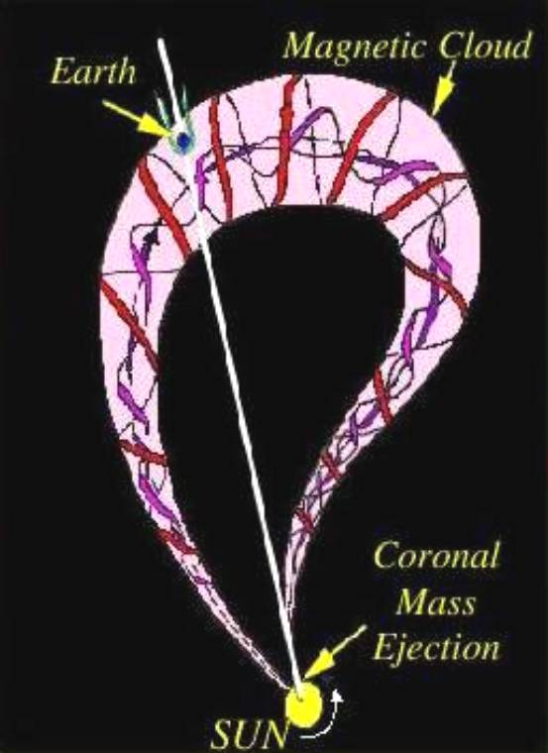
Magnetic Cloud

Slide 8
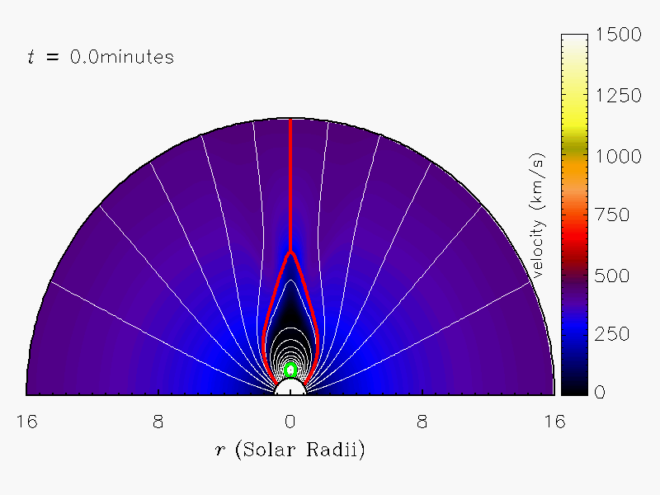
Shock
&
MC
[Hu & Chen et al.]
Notes:
How to avoid Aly-sturrock conjecture
Explain the two-ribbon flares
How to trigger
What’s the role of magnetic field reconnection

Slide 9
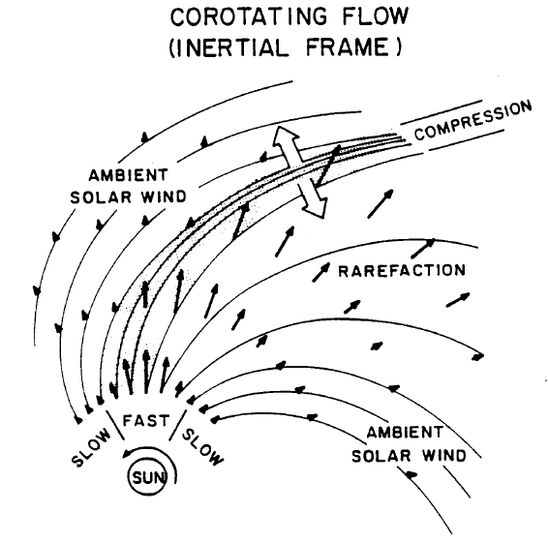
Corotating Interaction Region

Slide 10
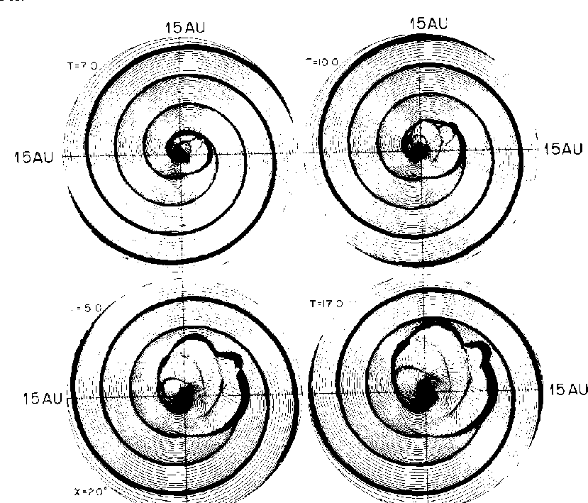

Slide 11
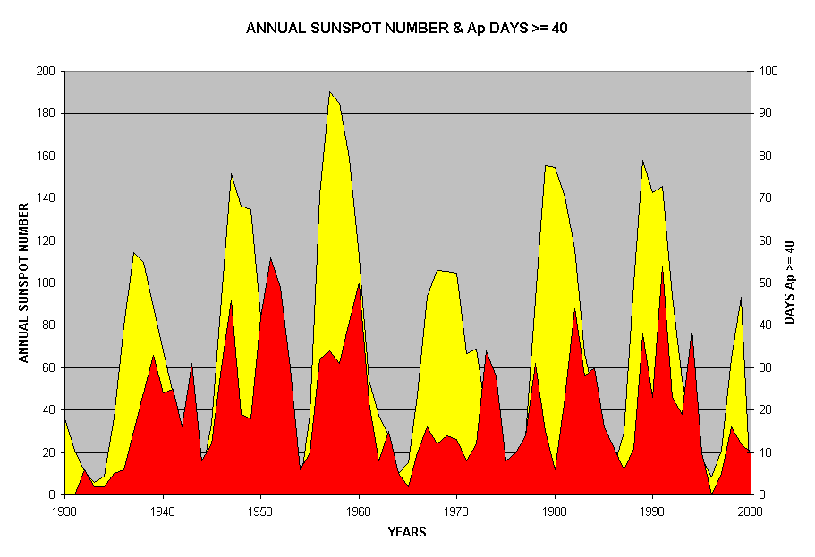
在太阳活动低年，地球有55%的时间处在高速流中，35%的时间处在低速太阳风中，还有约10%的时间处在与CME相关的瞬时结构中[Richardson et al., 2002]。在这期间，地磁扰动显著减弱，大磁暴（Dst_{min} <-100nT的）很少，大部分是由共转流相互作用区（CIR）引起的中等程度的重现性地磁暴[Sheeley, Jr. et al., 1976; Burlaga and Lepping, 1977; McAllister and Crooker, 1997; Webb et al., 2001]。共转流磁场的南向分量具有强的波动性，磁暴主相较弱并呈现出典型的不规则性。
在太阳高年，地球只有35%的时间处在高速流中，30%的时间处在低速太阳风中，大约有30%的时间处在与CME相关的瞬时结构中[Richardson et al., 2002]。此时，地磁扰动的程度显著增强，大磁暴产生较频繁，ICME（特别是磁云）[Klein and Burlaga, 1982]和激波后的鞘区[Tsurutani et al., 1988; Tsurutani and Gonzalez , 1997]成为引起地磁暴的主要行星际源。
特别值得注意的是，激波对前方南向磁场的压缩[Tsurutani et al., 1992a; Wang et al., 2003c]，抛射物前的（draping）[Gosling and McComas, 1987]，多重磁云[Wang et al., 2003a,b]等往往是特大地磁暴（Dst_{min}<-200nT）产生的主要原因。

Slide 12
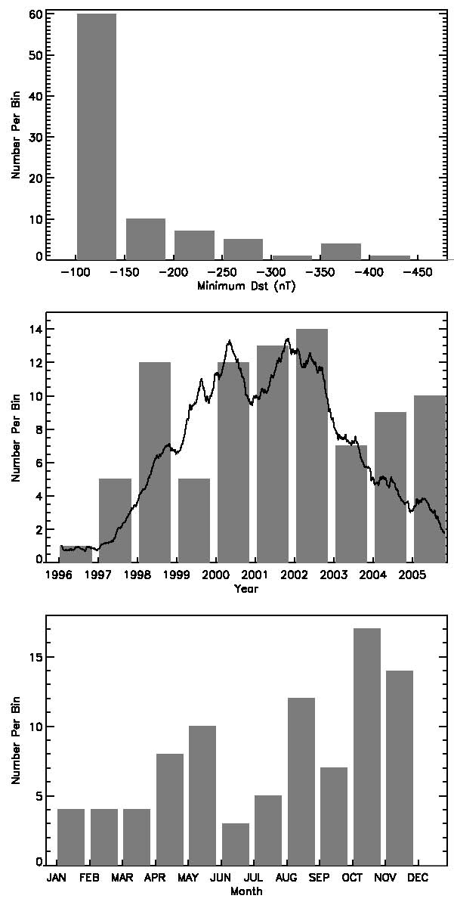
Distribution of Major Storms
88 Events
Size
Largest storm - 472 nT on Nov. 20, 2003
Solar Cycle
13 / yr at solar maximum
1 / yr at solar minimum
Calendar Month
Semiannual Variation
55 (second half) versus
33 (first half) ?
Zhang et al., 2007

Slide 13
Storm strength | Dst [nT] | Bz [nT] | dT [h]
Intense | -100 | -10 | 3
Moderate | -50 | -5 | 2
Small | -30 | -3 | 1

Slide 14
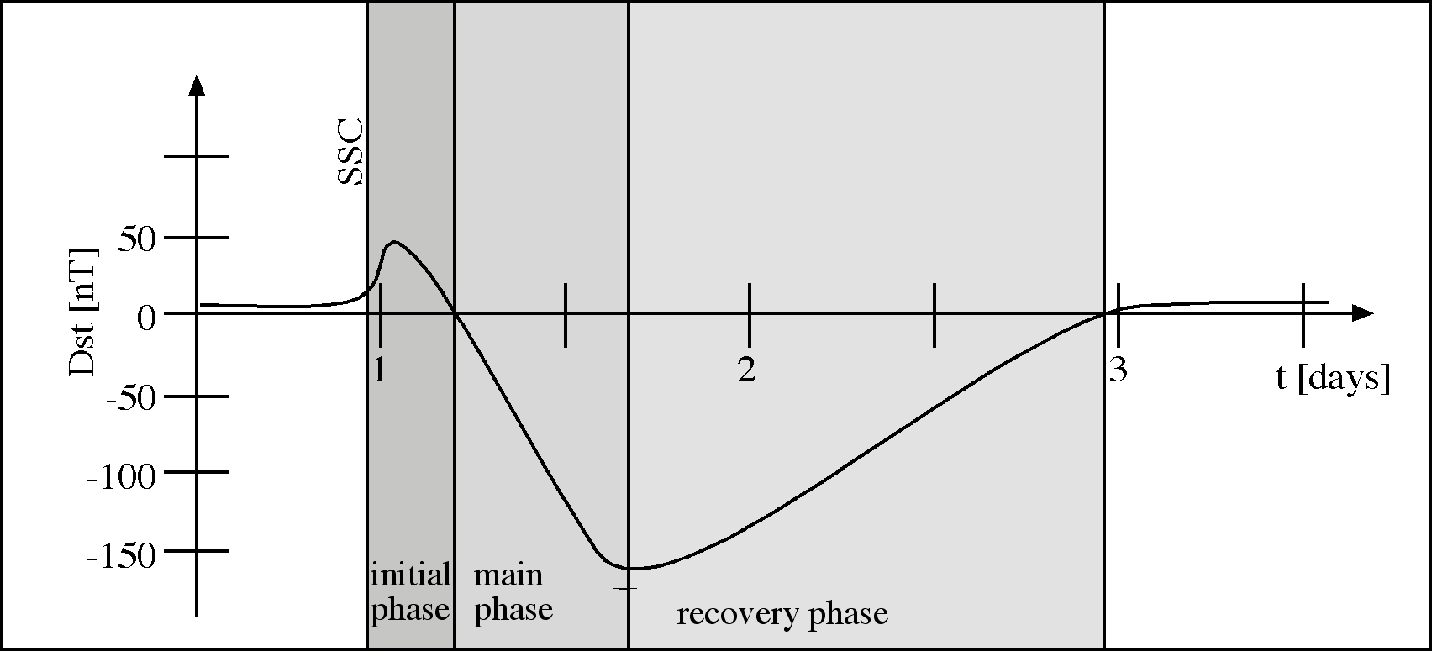
Phases of a storm

Slide 15
Initial Phase
  lasting from minutes to hours; Dst increases to positive values up to tens of nT
  dayside magnetopause is compressed inward (perhaps by several Re), with the following effects:
    magnetohydrodynamic waves are launched, and they propagate into the magnetosphere
    particle anisotropies favouring, e.g., certain Pc 1 wave type, are created

Slide 16
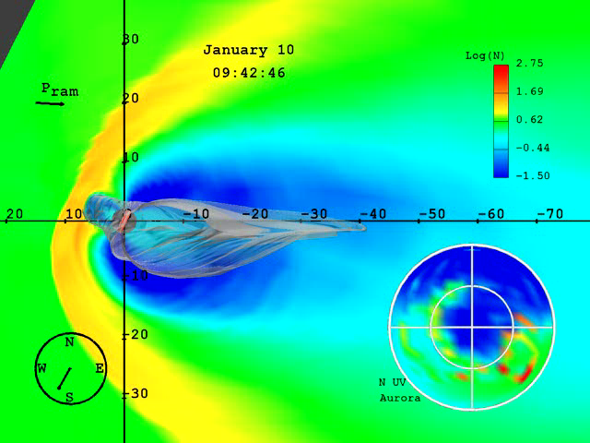
Shock-Magnetosphere Interaction

Slide 17
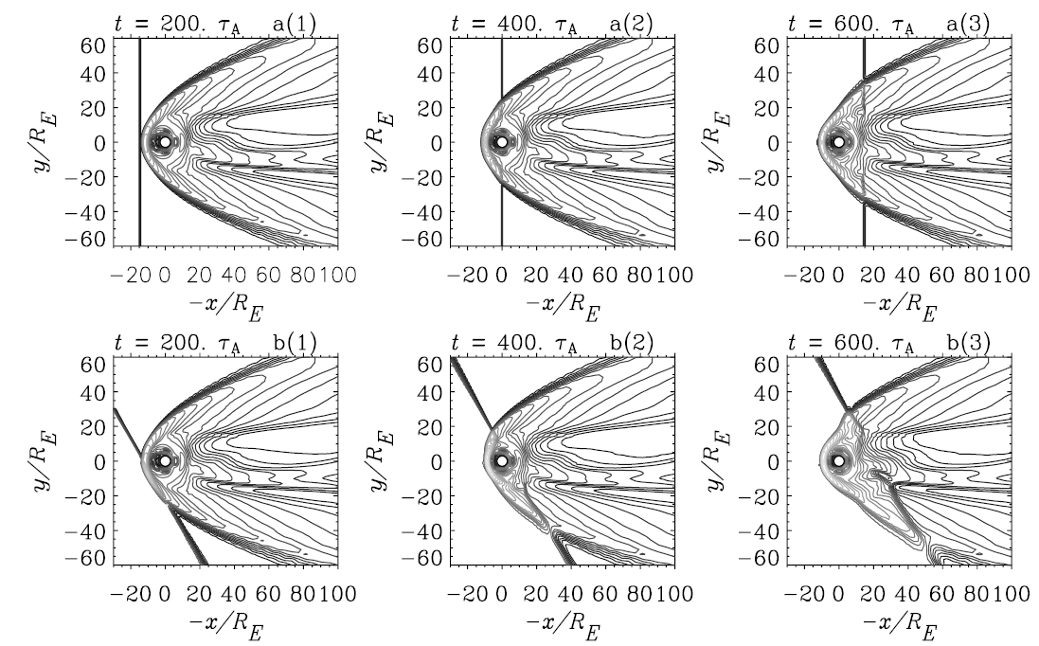
Contour of thermal pressure

Slide 18
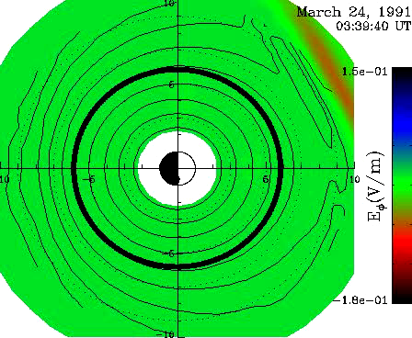
Shock-induced acceleration of particles

Slide 19
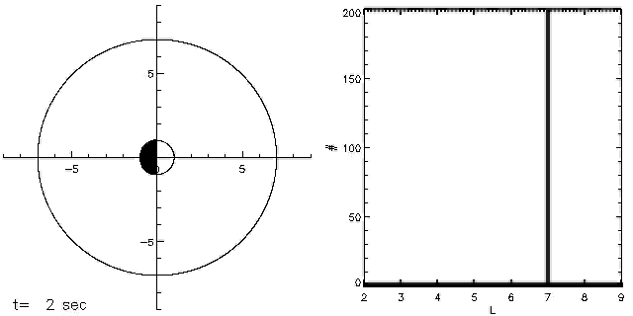
Simulation showing the coherent interaction of a ring of energetic electrons with an analytic impulse representing the effect of a shock in the solar wind.

Slide 20
Main Phase
  lasting from half an hour to several hours; Dst can reach negative values of hundreds of nT
  ring current is built up
  strong cross-tail electric field pushes the plasmapause closer to the Earth, and peels off the outer layers of the old plasmasphere

Slide 21
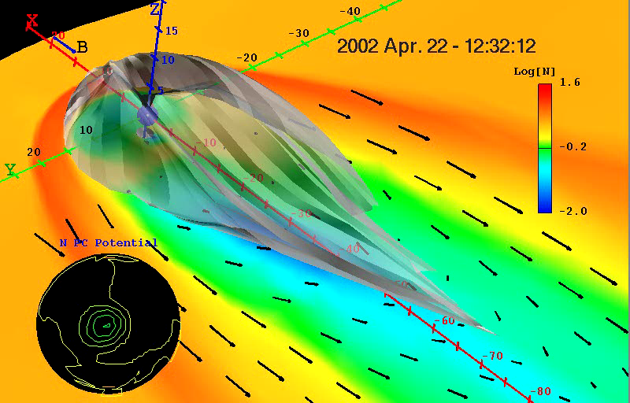
Substorm and storm dynamics of Earth’s magnetosphere. A movie example is developed for Apr. 22, 2002 storm event and provides a global view of complex dynamical behavior of the Earth’s magnetosphere and ionosphere. The semi-transparent grey mantle is the 3D envelope of the last-closed Earth’s magnetic field lines. Plasma flows are shown in black arrows and the density of the plasma is also shown in colors that denote large (red) and small (blue) values. Contours in the black circle show evolutions of electric field inside Earth’s ionosphere (~100 km above Earth’s surface).

Slide 22
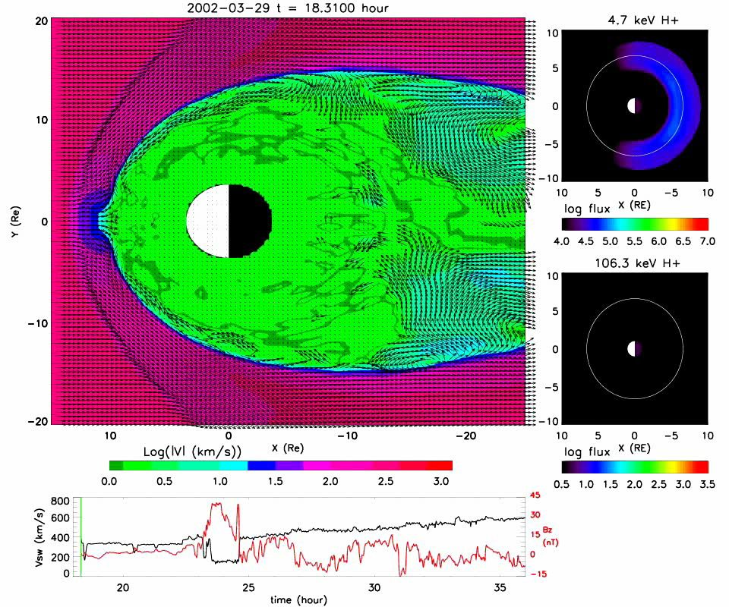

Slide 23
Effect of the Ring Current: Magnetic Field Perturbations

Slide 24
动态演化的等离子体层
IMAGE EUV observations on 18 June 2001
等离子体羽

Slide 25
Recovery Phase
  lasting from tens of hours to a week; Dst gradually returns to the normal level
  ring current ions are gradually lost:
    the expanding plasmasphere brings cold ionospheric plasma in connection with the ring current, resulting into ion-cyclotron wave growth and scattering of the ring current ions into the loss cone
    ring current become energetic neutral atoms due to charge-exchange with the cold neutral hydrogen
  Periodically structured Pc1 pulsations seen

Slide 26
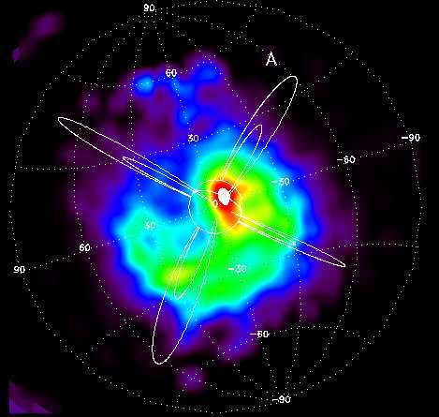
环电流中性原子成像

Slide 27


Slide 28
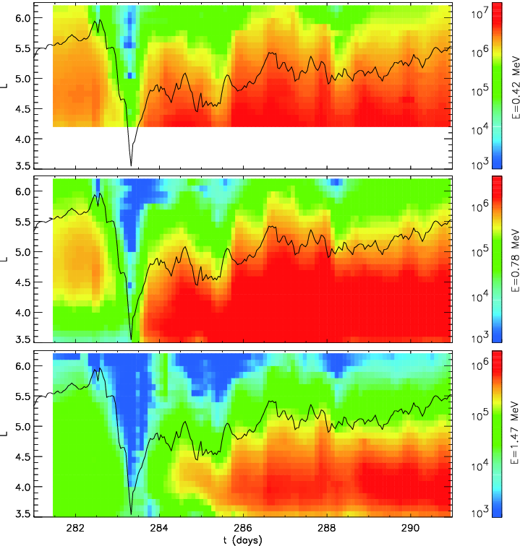
辐射带对磁暴响应
1990 年 10月 8日磁暴期间CRRES卫星观测结果 [Albert et al., 2009]
主相
快速下降
恢复相
逐步上升

Slide 29
Substorm
Substorms are brief (1-3 hour) magnetospheric disturbances
Occur when the interplanetary magnetic field turns southward, permitting interplanetary and terrestrial magnetic field lines to merge at the dayside magnetopause and energy to be transferred from the solar wind to the magnetosphere.
磁层亚暴是从地球夜侧开始的一种爆炸式的释能过程，是一种重要的磁层活动现象，是地球磁层动力学性质最生动的表现。一次亚暴过程的持续时间约为1-3小时，释放能量约10¹⁴--10¹⁵焦耳。

Slide 30
Phase of Substorm
Growth phase : The storage of some of in the Earth's magnetotail
能量由太阳风转移到磁尾储存起来
Expansion phase, the energy stored in the tail is released when the field lines in the inner magnetosphere relax from their stretched, tail-like configuration and "snap" back into a more dipolar configuration
能量爆炸式地释放
Recovery phase, the magnetosphere returns to its quiet state.
磁层弛豫到平静时的状态

Slide 31
磁层亚暴作为一个总体包括多个不同方面的扰动:
大量高温等离子体侵入磁层，电离层电流突然变化，从而产生极区磁亚暴；
大量高能粒子注入高层大气引起中性大气电离或激
发而产生极光，即极光亚暴；
注入高层大气的大量带电粒子，造成电离层附加电力，使电离层发生激烈的扰动，即电离层亚暴；

Slide 32
亚暴最易见的显示是全球极光表现的演变，
可以把极光演变的时间序列看作是磁层中
的亚暴扰动沿着磁力线投影到电离层的投
影。
亚暴的演化过程可以用极光的演化来说明。

Slide 33
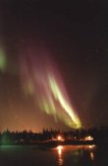
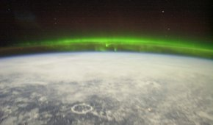
Image 1. Northern lights observed in Canada (Credit: Canadian Space agency
/Agence Spatiale Canadienne)
Image 2. Auroras over Canada pictured from the International Space Station - altitude: ~400 km - with the Manicouagan impact crater in the foreground (Credit: NASA)

Slide 34
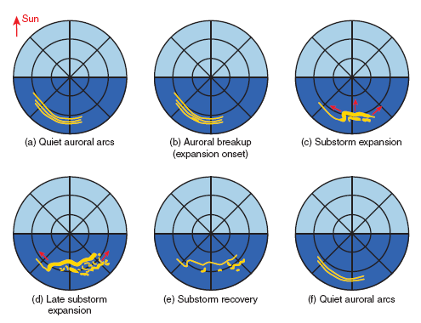
简图表示在极光亚暴期间直接从磁极方向看到的极光的演化序列.
图中的同心圆环表示纬度空间的10度间隔.

Slide 35
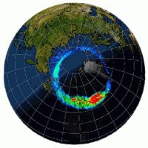
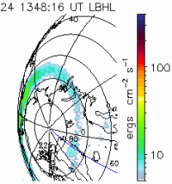
Image 3. Auroral oval (in false colour) as seen from space, overlaid on top of a visible image of Earth. The red indicates the brightest aurora and blue the dimmest. The brightest aurora is found at midnight. (Credit: Holzworth and Meng, NSSDC, NASA)
Animation 1. This sequence of images captured by the Ultraviolet Imager on NASA's Earth-orbiting POLAR satellite shows a magneto-spheric substorm over northern Asia on 24 February 2000. Maximum activity, denoted by dynamic yellow blobs in the aurora oval, occurs around 1400 UT. (Credit: NASA)

Slide 36
AE magnetic index
The auroral electro jet index, AE, is designed to provide a global, quantitative measure of auroral zone magnetic activity produced by enhanced ionospheric currents flowing below and within the auroral oval.
It can be derived on an instantaneous basis or from averages of variations computed over any selected intervals. It is quantitative and relatively simple and utilizes computer processing techniques.

Slide 37
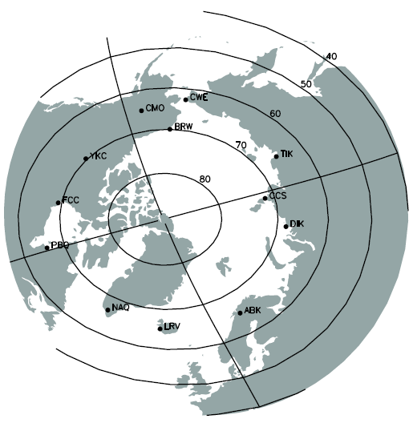
Auroral Electrojet Index (AE)
Distribution of
AE(12) stations.
地磁观测H分量
AE=AU‐AL
AU 为链上任何台站在任意瞬时记录的最大扰动
AL指数为下包络线所确定的最小扰动。

Slide 38
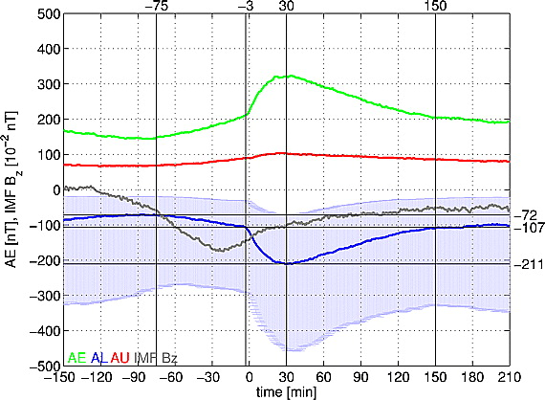
Expansion
Recovery
Grouth

Slide 39
注意:亚暴中以极光电急流形式释放能量只是总亚暴能量中的很小一部分.大部分的能量释放是通过环电流,越尾电流,等离子体片中的等离子体和磁场变化,可能还有磁层中等离子体团的形成和它的尾向运动.

Slide 40
近地中性线模式(NENL) (McPherron,1973 )
近地电流中断模式(NECD)(Lui,1991)
磁层电离层耦合模式(MIC)(Kan,1990)
边界层动力学模式(PSBL)(Rostoker & Eastman, 1987)
热灾变模式(TC)(Geortz & Smith,1989)
磁层亚暴的各种物理模式:

Slide 41
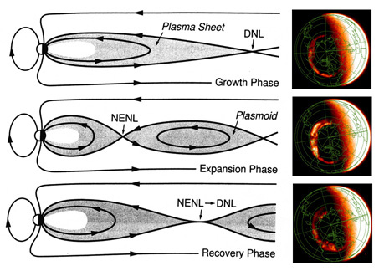
Substorm and Aurora

Slide 42
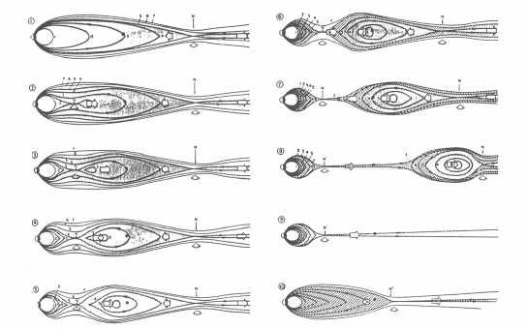

Slide 43
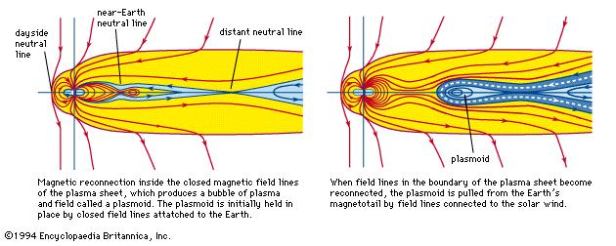
Expansion Phase

Slide 44
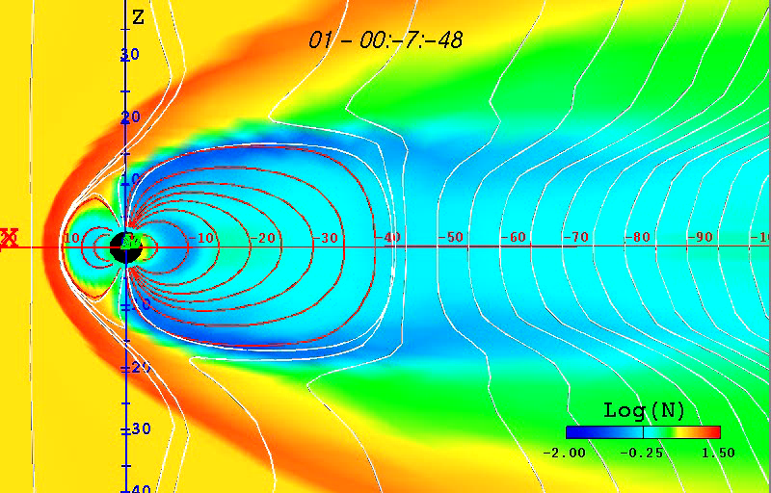
PLasmamoid

Slide 45
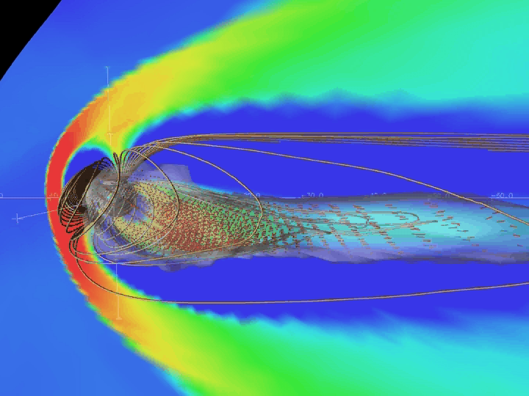

Slide 46
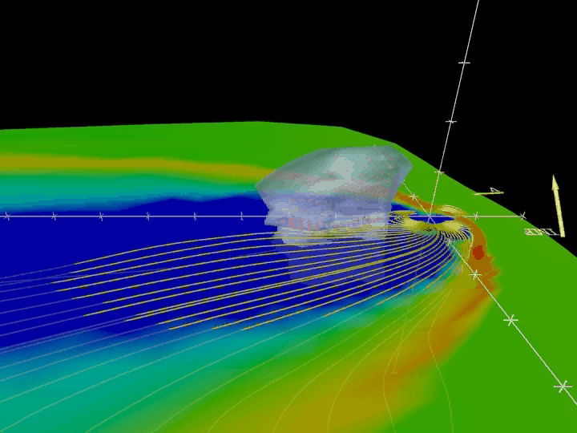
The plane is colored in the logarithm of the density, there are yellow magnetic field lines,The translucent surface anti-sunward of the earth is the plasma sheet

Slide 47
近地中性线模式成功之处:
等离子团的形成
(Moldwin, M.B., and W.Hughes,1993,
Zong, Q.-G., et al.,1997)
高速流
(Cao et al., 2006)

Slide 48
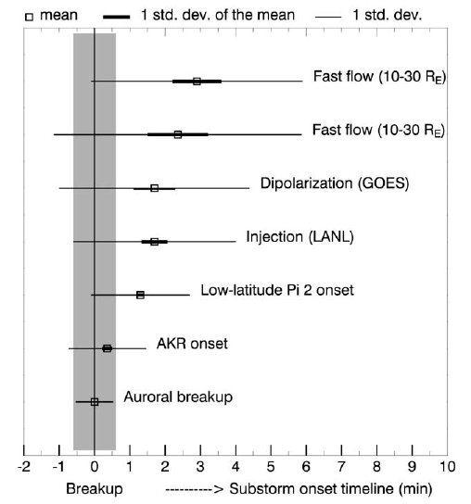
?
亚暴开始的时间
（ONSET TIMING）
Auroral breakup

Slide 49
亚暴开始的地点
——THE ONSET LOCATION
Satellite Sample MLT(hours) MLAT(deg.) References
DE-1 68 2250(22.8) 65 CF91
Viking 133 2305(22.8) 66.7 HM95
Polar UVI 648 2230(22.7) 67 Liou01
IMAGE FUV 2400 2300 66.4 FR04

Slide 50
磁暴和亚暴的区别
 | 磁暴 | 磁亚暴
发生条件 | IMF持续南向一段时间 | IMF转南向
主要影响纬度 | 中、低纬度 | 高纬度
观测特征 | 地球表面中低纬所量测到的磁场异常变动 | 地球极区所观测到之异常地磁扰动
持续时间 | 数天 | 约3小时
磁场变化幅度 | 约0.0005Gauss | 约0.005~0.01Gauss
发生频率 | 1个月1~2次(极大期)或1年数次(极小期)( ) | 数小时发生一次
Index | Dst | AU、AL、AE

Slide 51
Substorm Injection
One of the most typical indicators of a substorm onset is the ‘‘injection’’ of high-energy particles (between tens and a few hundred keVs) into the nightside region of the magnetosphere.
During a substorm injection the particle energization can be almost simultaneous for a wide energy range; the rise in particle flux for different energies occurs within 1 min. In such a case the injection is called ‘‘dispersionless.’’
Dispersionless injections, characterized by sudden, large increases in particle fluxes (one to two orders of magnitude), are generally localized near midnight in local time [Belian et al., 1978; Lopez et al., 1990; Thomsen et al., 2001] (with the exception of a few which occur away from midnight [Friedel et al., 1996]) and are confined to a rather narrow local time ‘‘wedge’’ of typically 60 to 70 [e.g., Clauer and McPherron, 1974]. Another interesting property of the injections is their radial propagation pattern in the earthward direction; radially displaced satellites have definitely shown [Russell and McPherron, 1973; Moore et al., 1981; Reeves et al., 1996] that the injection occurs first at the outer satellite.

Slide 52
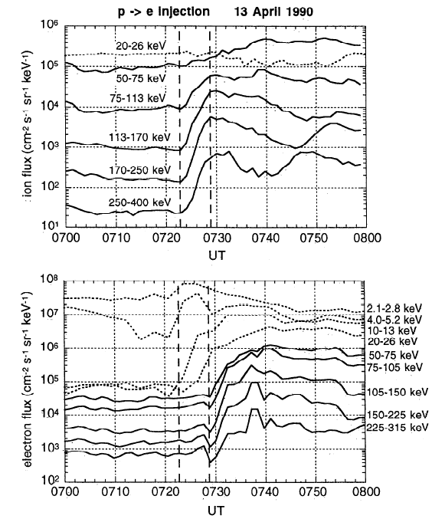
Substorm Injection

Slide 53
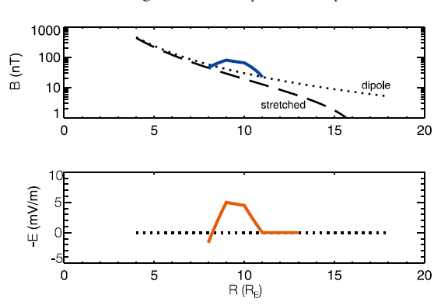
[Zaharia et al., 2004]
Eletromagnetic pulse associated with substorm injection

Slide 54
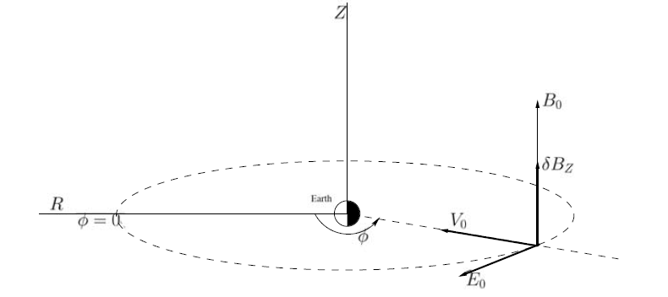
Electric and magnetic fields in the midnight sector in the cylindrical coordinate system (R, Phi, Z) centered at Earth. The westward E_phi and northward Delta_B_{Z} are the transient fields of the earthward propagating pulse; B0 is the background B field [cf. Zaharia et al., 2000].

Slide 55
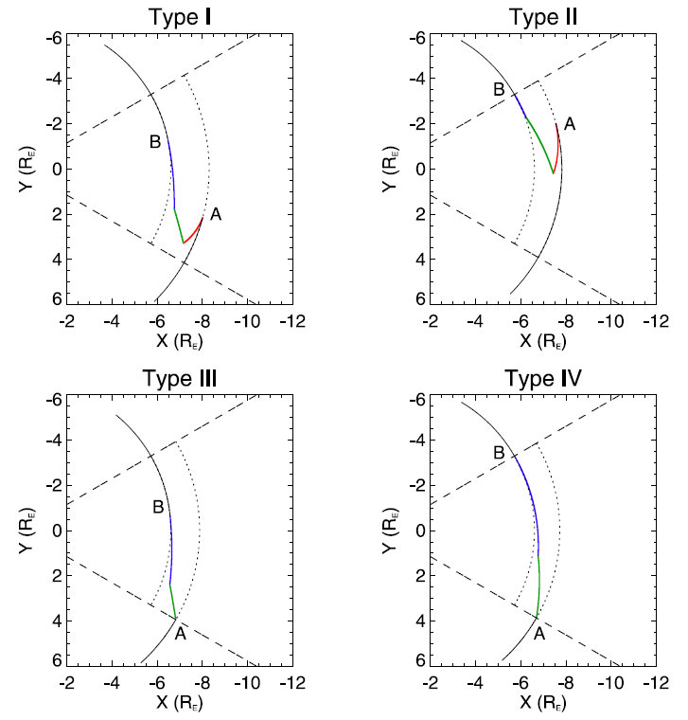
Test Electron Trajectory

Slide 56
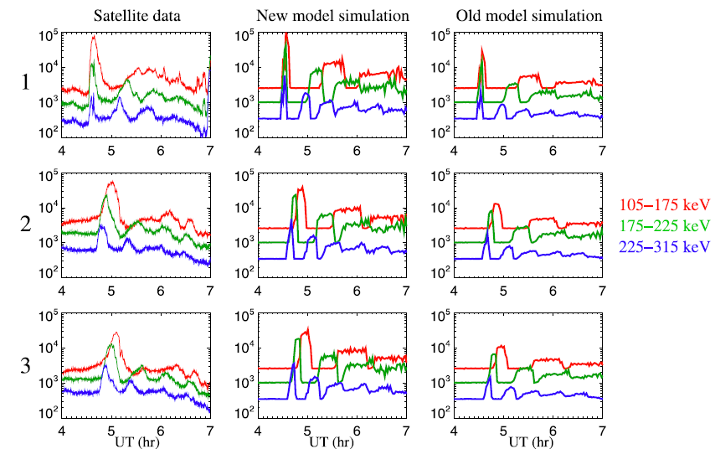
Test-particle simulation results

Slide 57
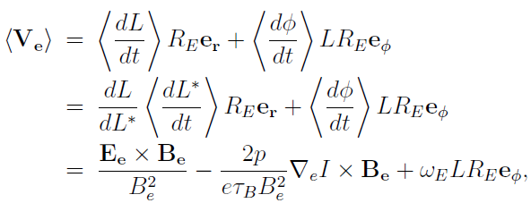
STEERB simulation
Drift velocity
The equatorial electric field E_{e} consists of the Kp-dependent convection electric field E_{c} [Volland, 1973; Maynard and Chen, 1975] and the substorm-related impulsive electric field E_{i}

Slide 58

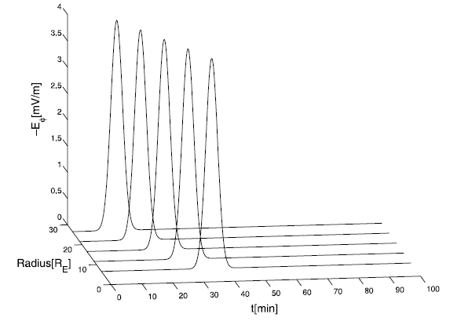

Slide 59
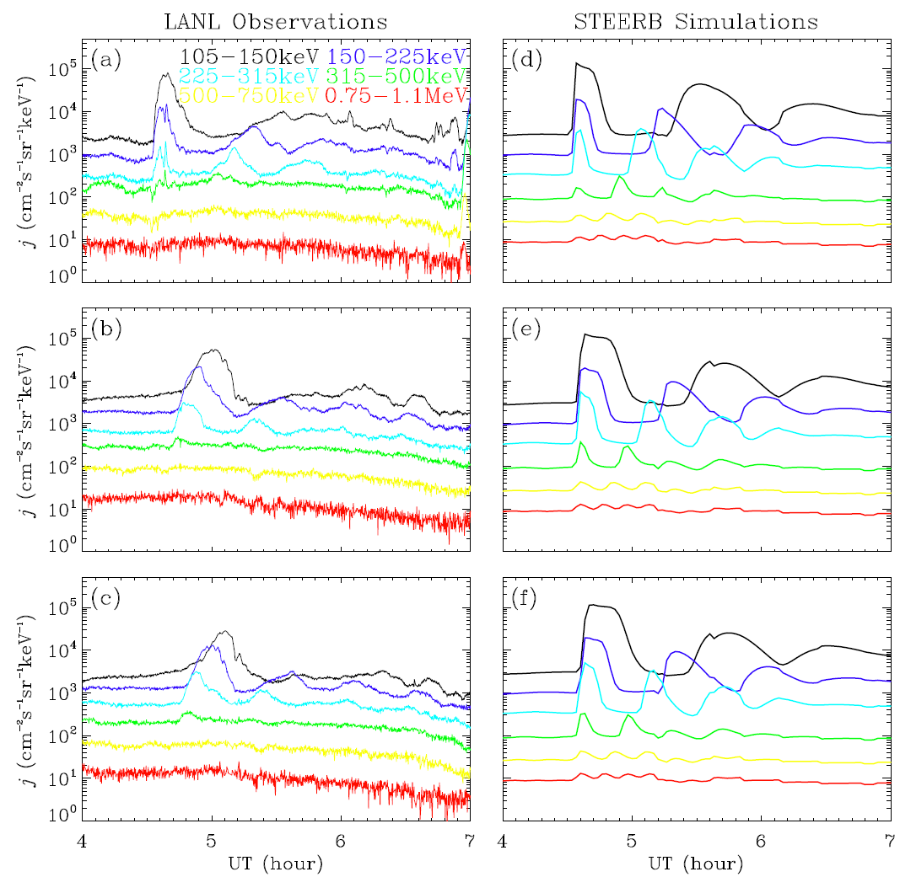

Slide 60
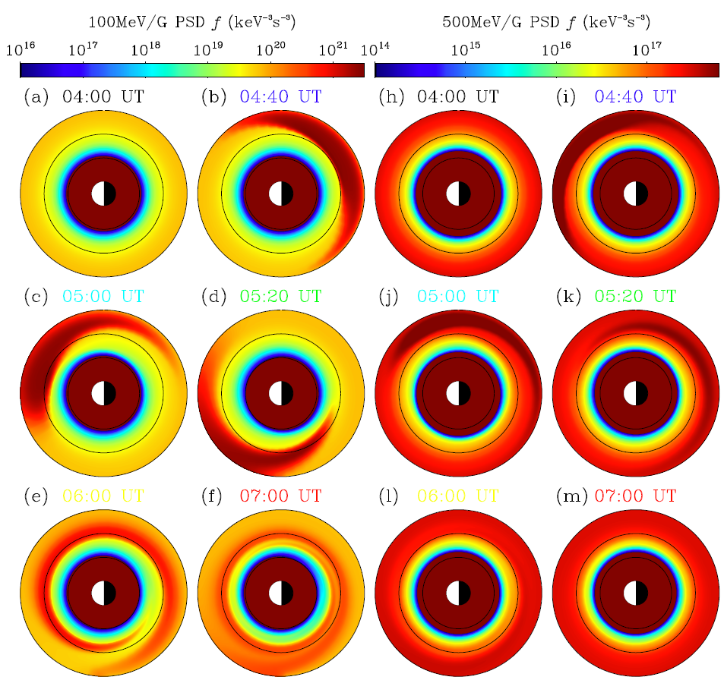

Slide 61
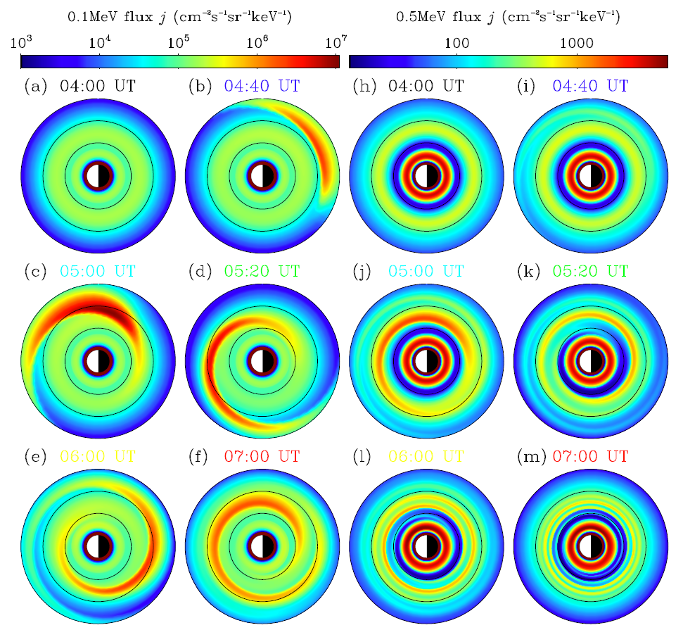

Slide 62
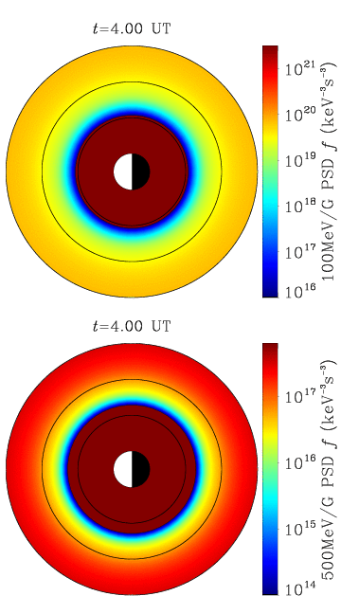
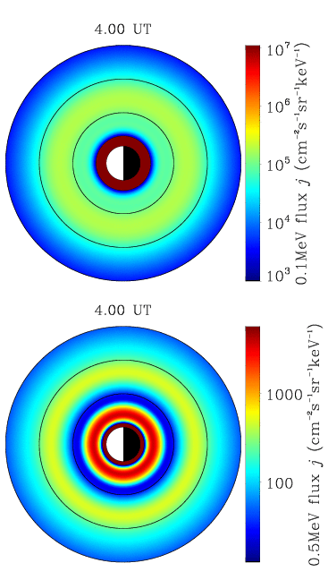
Animation of STEERB simulation

