Slide 1
Magnetospheric Particle Dynamics
&
Wave-particle Interaction

Slide 2
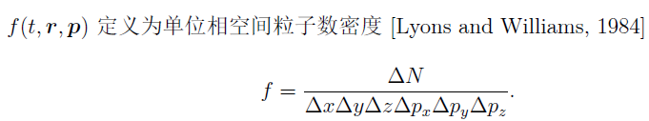
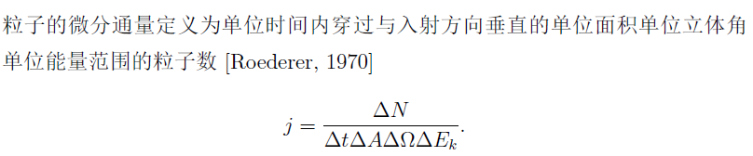

Basic Concepts
Phase space distribution (Phase space density)
Differential flux

Slide 3

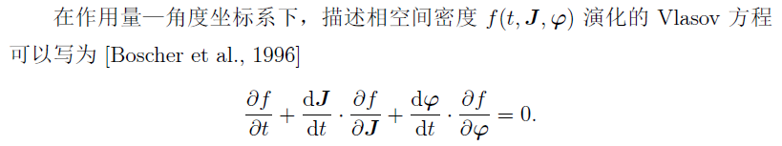
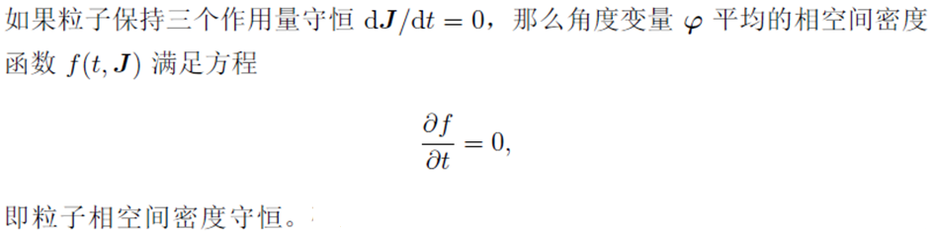
Basic Theory
Vlasov Equation

Slide 4
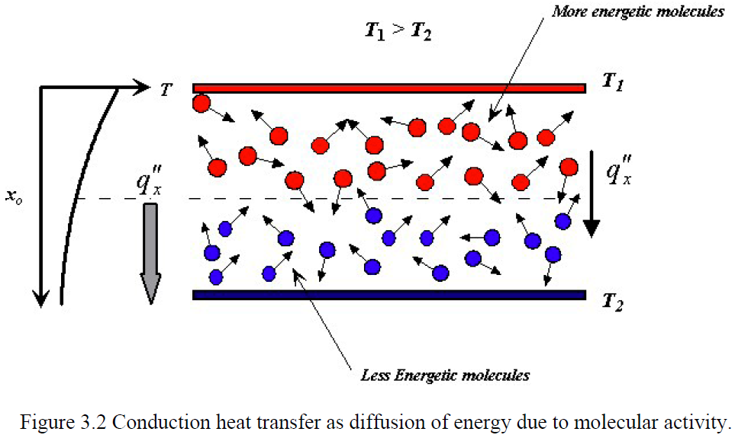
Basic Theory
Energy Transfer: Diffusion (Random)

Slide 5
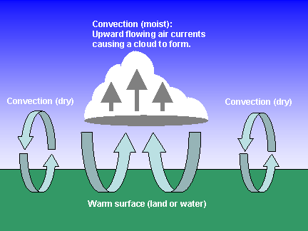
Basic Theory
Energy transfer: Convection (Deterministic)

Slide 6
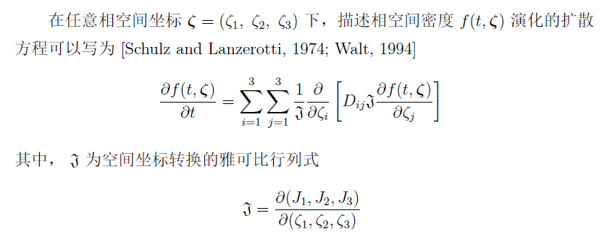
Convection-Diffusion-Type
Fokker-Planck Equation

Slide 7
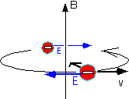

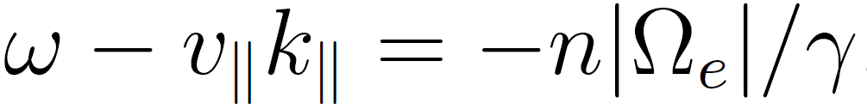
Gyro-resonance
Plane Wave
Gyro-resonant
Conditions

Slide 8
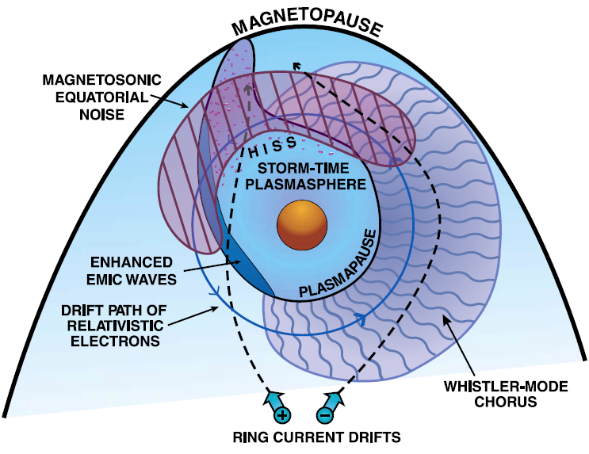
Gyro-resonance
Gyro-resonance with VLF/ELF waves
ELF(3 Hz–3 KHz) VLF(3 KHz-30 KHz)
Violating the 1st and 2nd adiabatic invariants,
Conserving the 3rd adiabatic invariant
Local diffusion in pitch-angle, momentum, and cross term
[Thorne, 2010]

Slide 9
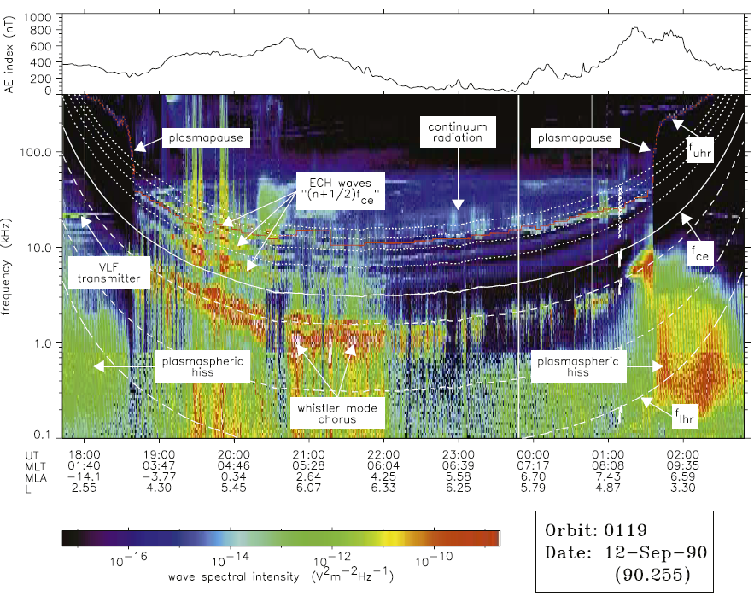
Wave Spectrum Observed by CRRES satellite.

Slide 10
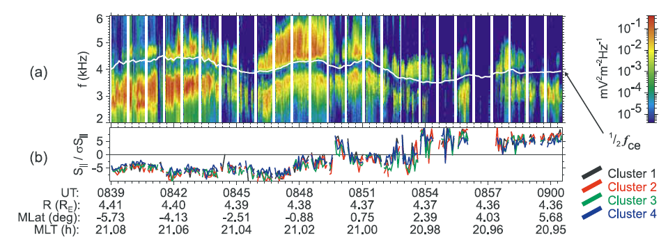
Chorus observed by CLUSTER
Upper band > 0.5f_{ce}
Lower band < 0.5f_{ce}

Slide 11
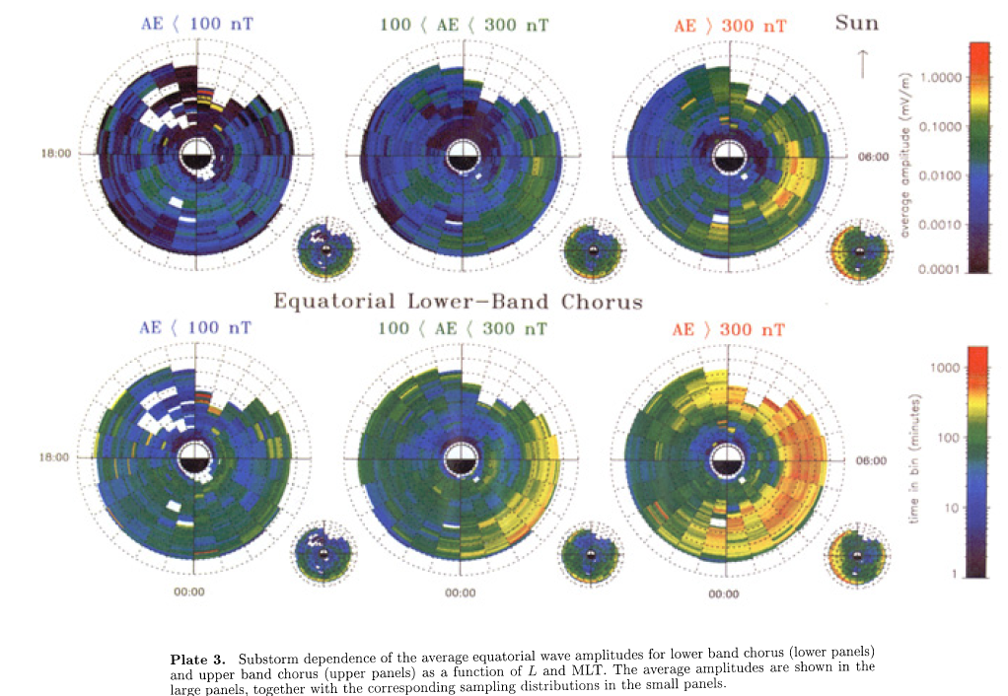

Slide 12
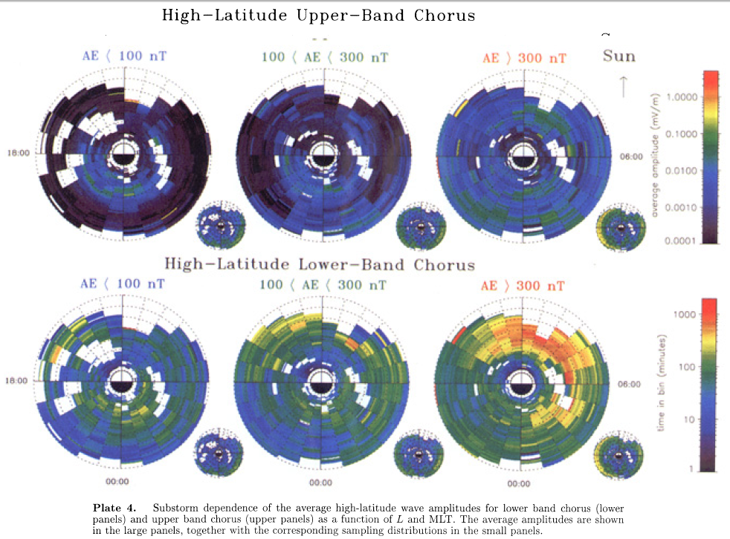

Slide 13
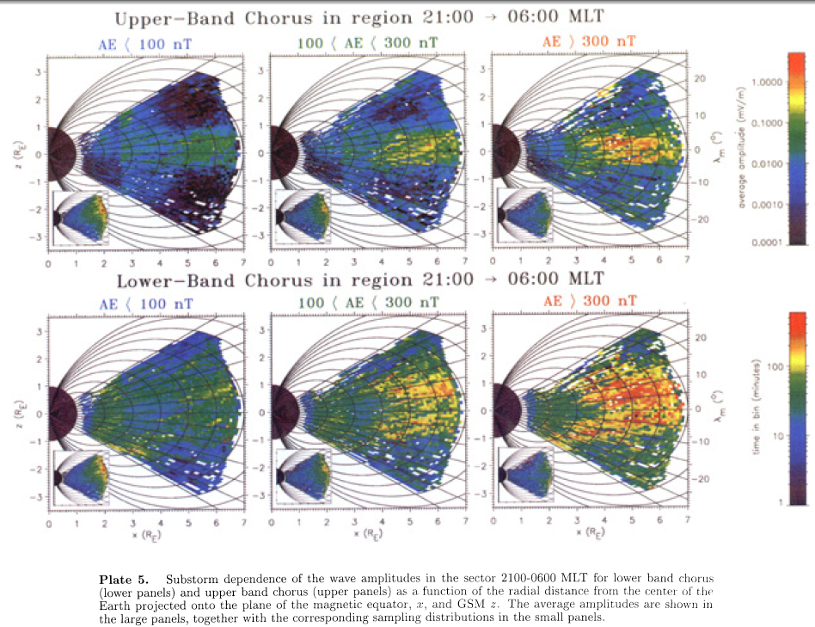

Slide 14
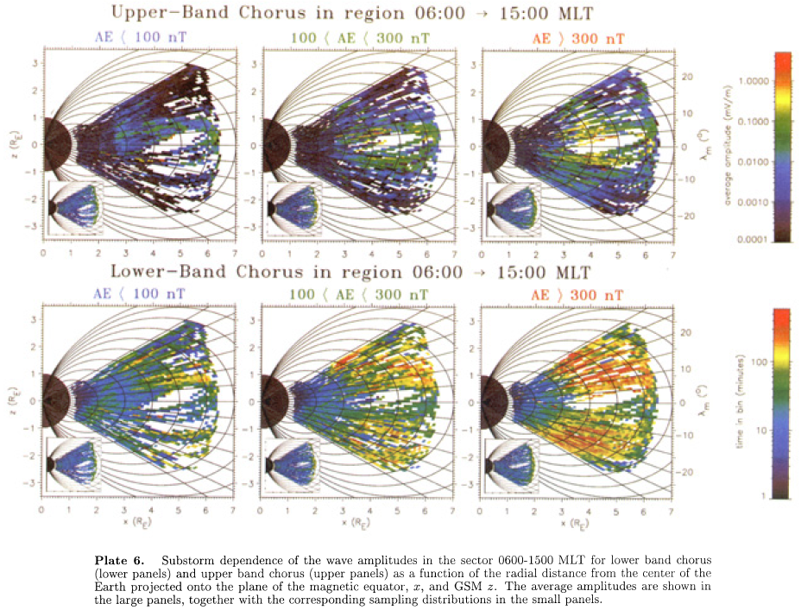

Slide 15
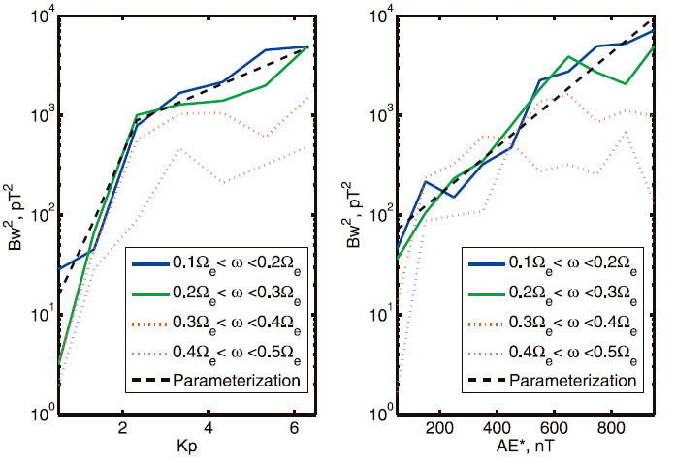
Kp/AE-dependent chorus amplitude

Slide 16
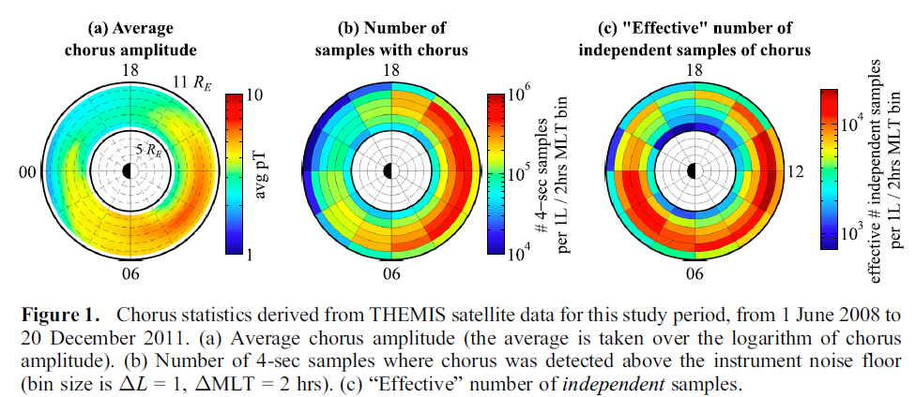
Chorus waves observed by THEMIS
Dependence on interplanetary parameters?

Slide 17
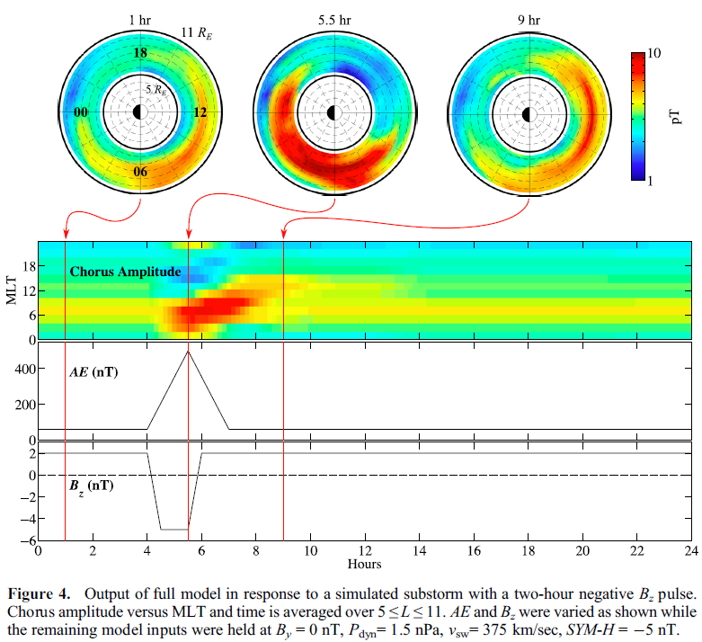

Slide 18
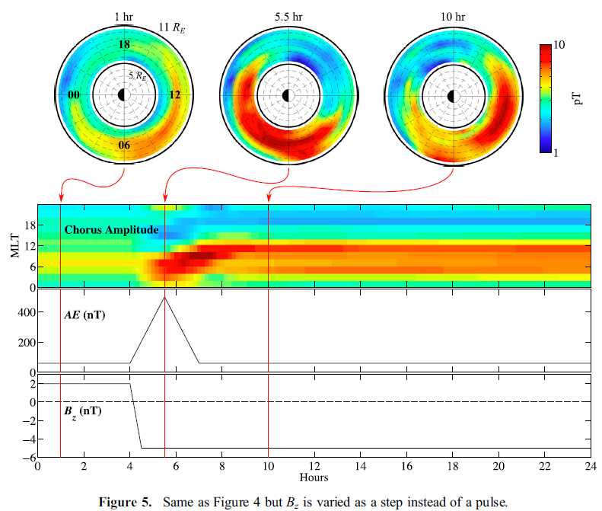

Slide 19
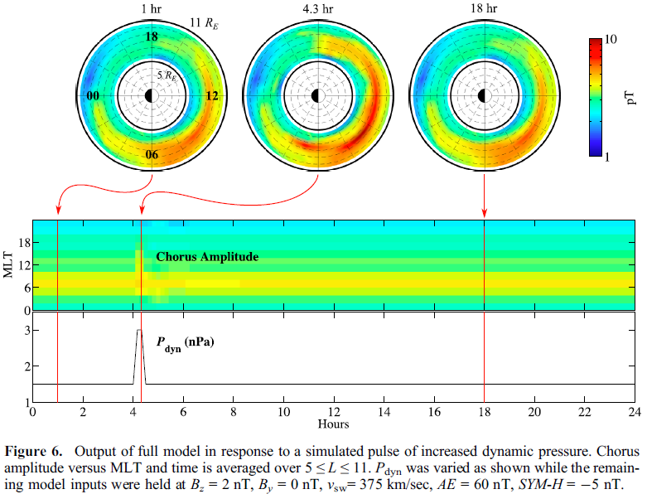

Slide 20
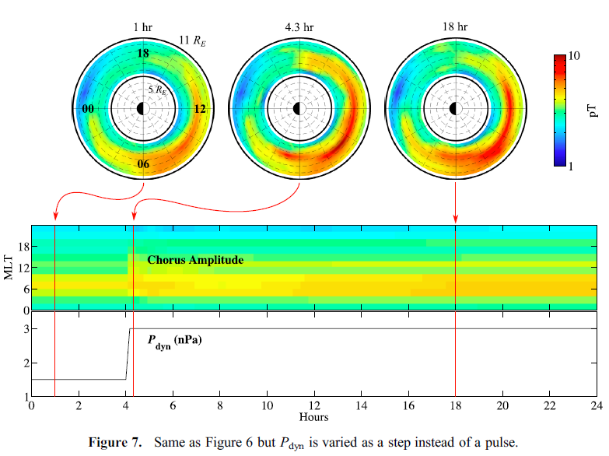

Slide 21
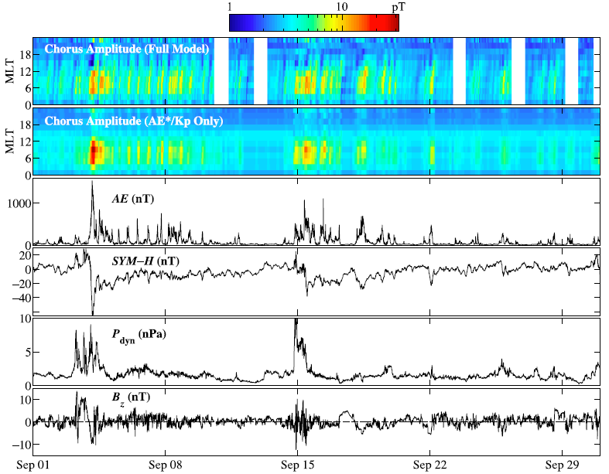

Slide 22
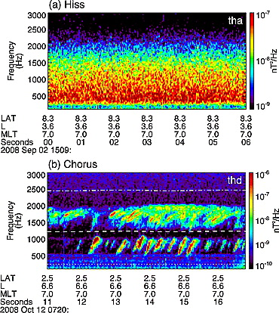
Plasmaspheric hiss and chorus observed by THEMIS spacecraft

Slide 23
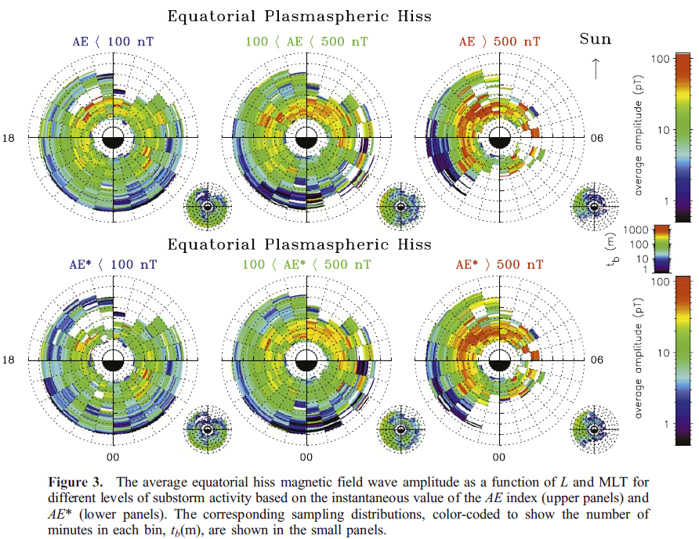

Slide 24
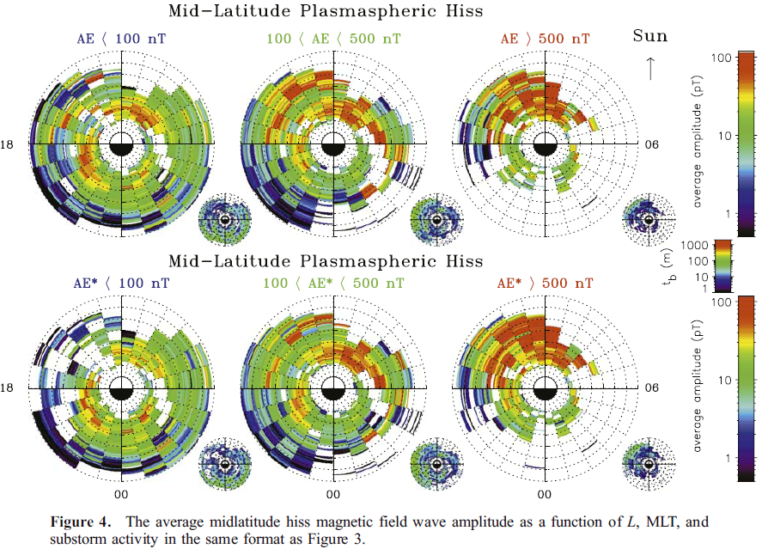

Slide 25
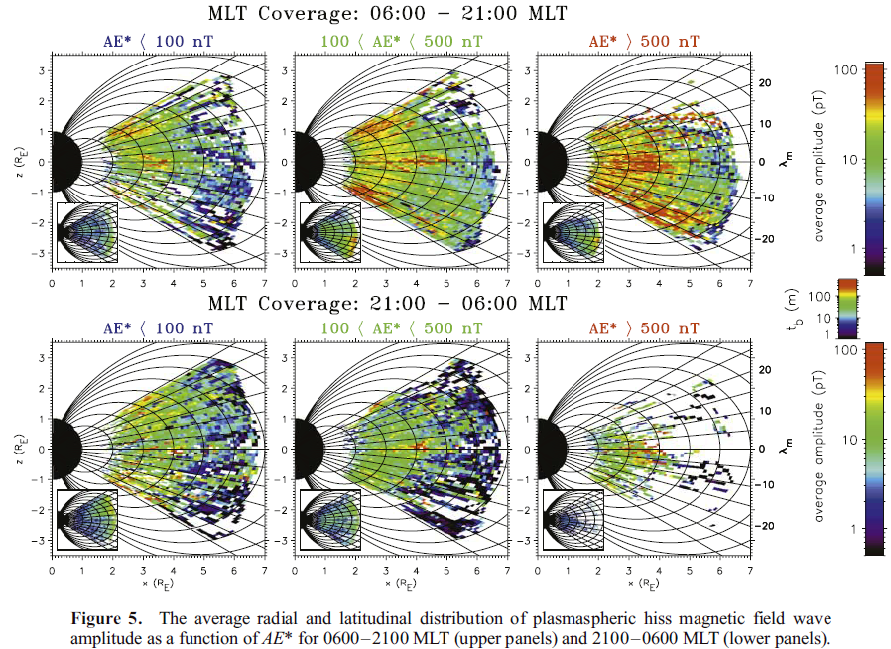

Slide 26
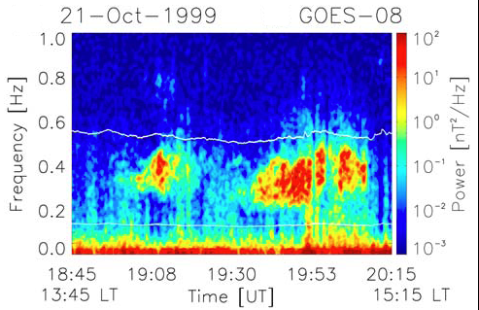
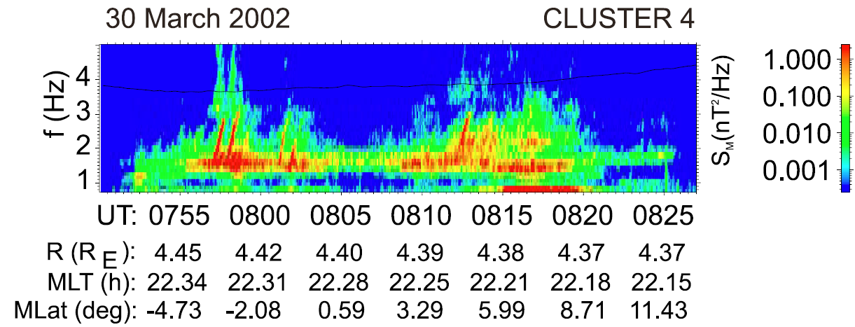
EMIC wave characteristics
Distributed in the high density plasmapause and plasmaspheric plume region [Anderson et al., 1996; Horne and Thorne, 1993; Jordanova et al., 2008]
Three bands: H, He, O [Meredith et al., 2003; Fraser et al., 2010]
Broadband incoherent spectrum [e.g., Anderson et al., 1992a, b]
Narrowband packets with rising tone [Pickett et al., 2010]
Typical amplitudes: 1-10nT [Meredith et al., 2003; Fraser et al., 2010]
[Pickett et al., 2010]
[Thorne, 2010]
Occurrence of nonlinear processes
[Albert and Bortnik, 2009]
[Fraser et al., 2010]

Slide 27
Drift-resonance
Drift-resonance with ULF waves (1 mHz to 1 Hz geomagnetic pulsations)
Violating the 3rd adiabatic invariant
Conserving the 1st and 2nd adiabatic invariants
Radial diffusion
Empirical loss terms near the Earth and in the slot region.

Slide 28
Classification of ULF wave
Pulsation Classes
 | Continuous pulsations |  |  |  |  | Irregular pulsations
 | Pc 1 | Pc 2 | Pc 3 | Pc 4 | Pc 5 | Pi 1 | Pi 2
T [s] | 0.2-5 | 5-10 | 10-45 | 45-150 | 150-600 | 1-40 | 40-150
f | 0.2-5 Hz | 0.1-0.2 Hz | 22-100 mHz | 7-22 mHz | 2-7 mHz | 0.025-1 Hz | 2-25 mHz

Slide 29


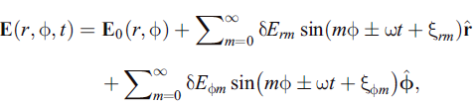

Drift-resonance
Equatorial magnetic field
Drift path
ULF electric magnetic field

Slide 30
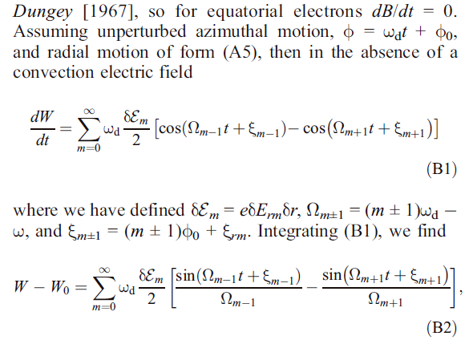
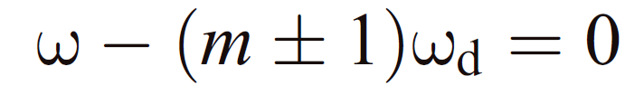
Drift resonance condition

Slide 31
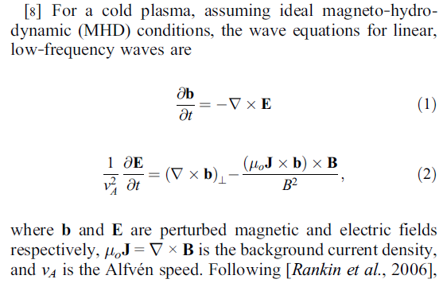
MHD simulation on ULF wave

Slide 32
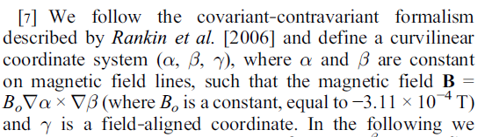
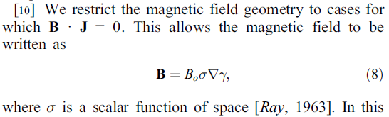
MHD simulation on ULF wave

Slide 33
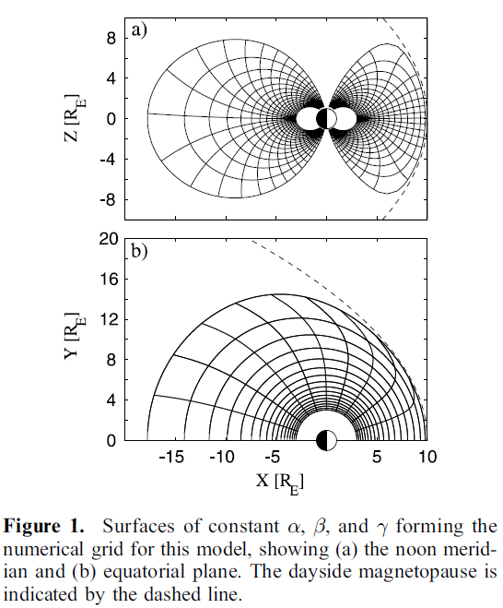
Simulation
Coordinates

Slide 34
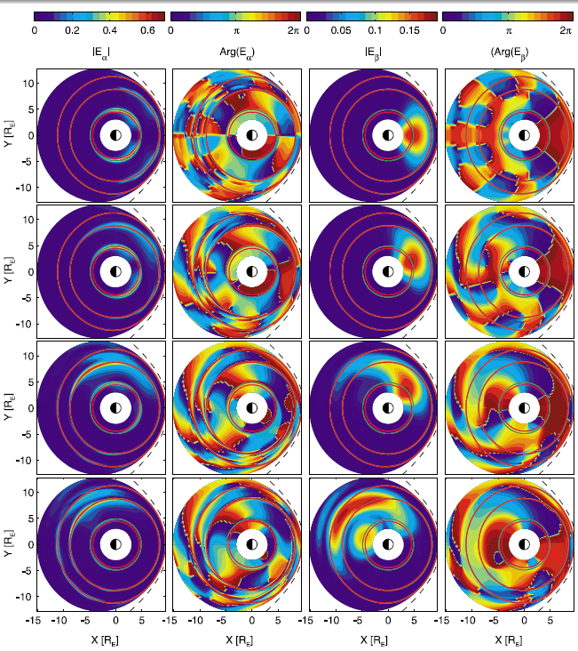


Slide 35
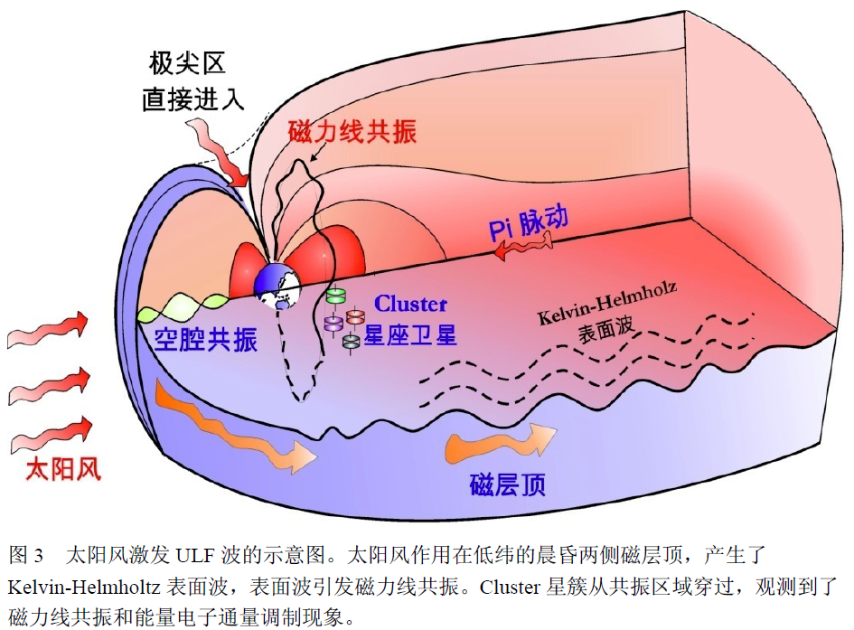

Slide 36
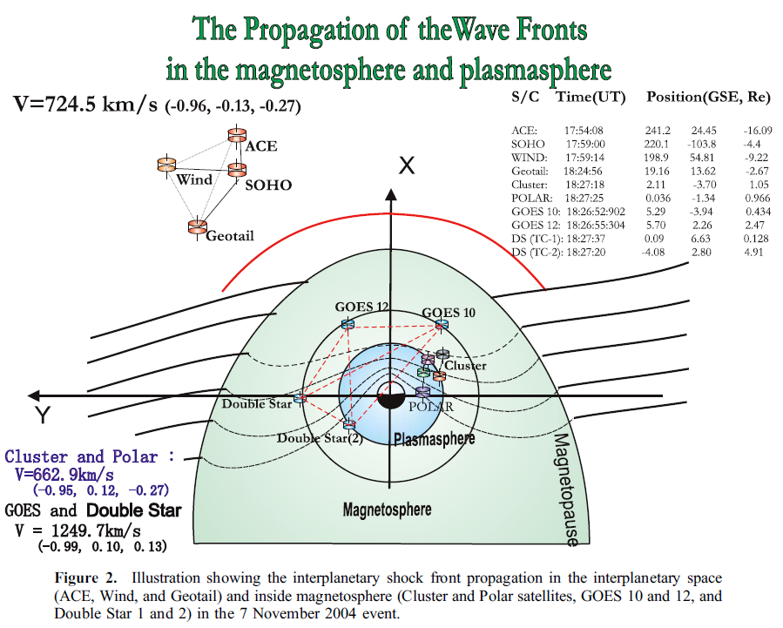
ULF wave observed by CLUSTER

Slide 37
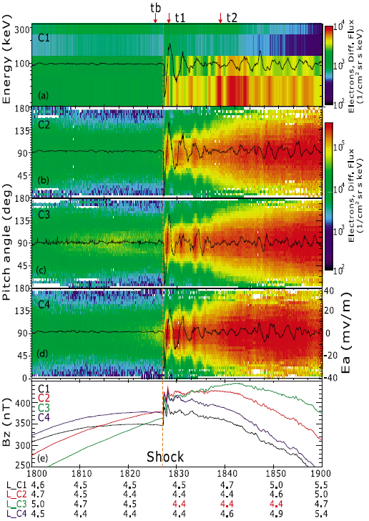
ULF wave observed by CLUSTER

Slide 38
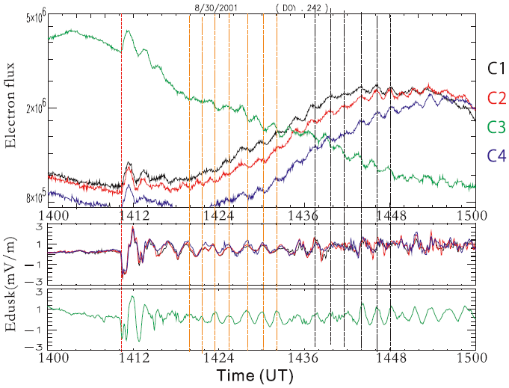
Electron flux modulated by ULF wave

Slide 39
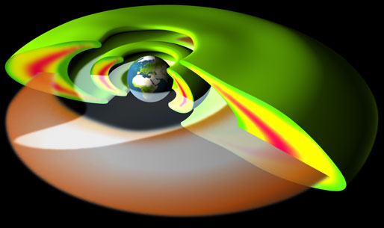
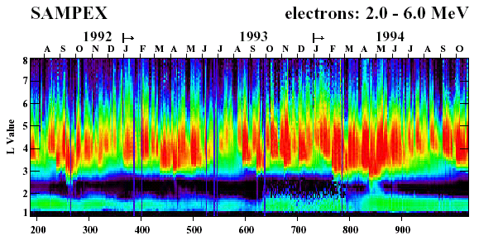
Electron radiation belt
Electron radiation belt
  Relatively stable inner belt (1.2-2.0) Re
  Highly dynamic outer belt (3.0-8.0) Re
Discovery of Van Allen radiation belts – Explorer 1, 1958
[Van Allen and Frank, 1959; Van Allen et al.,1959]
A resurgence of interest in recent times
  Hazards to space-borne systems
  Challenging scientific problems surround the radiation belt dynamics

Slide 40
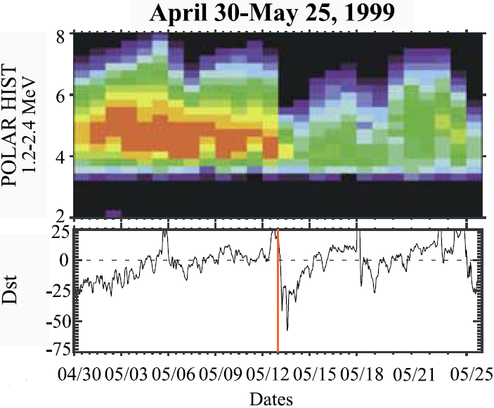
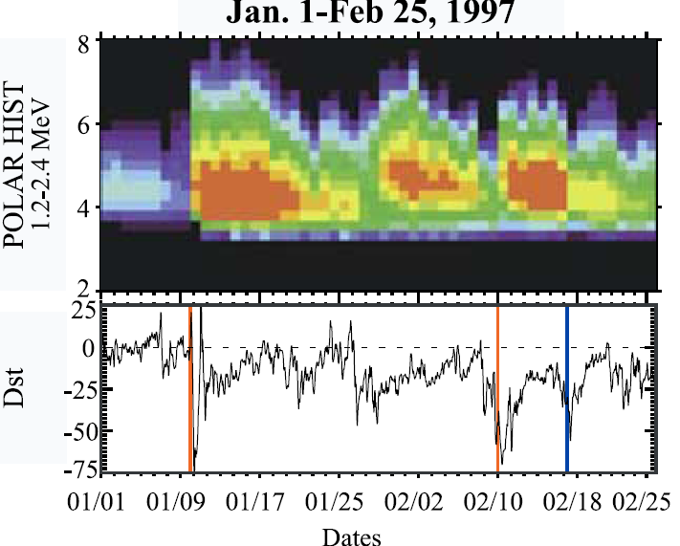
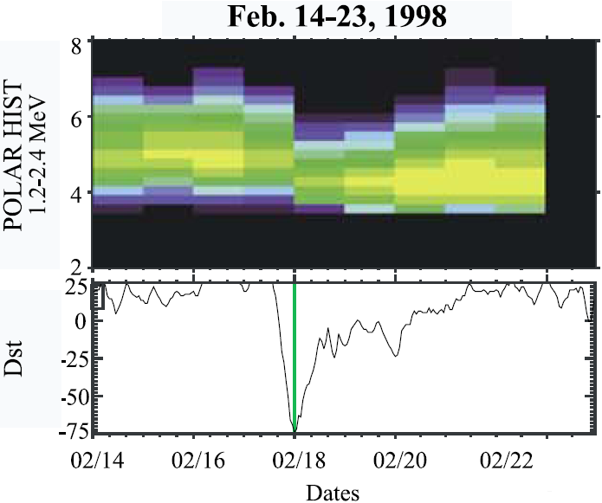
Electron radiation belt dynamics
[Reeves et al., 2003]
50% Net Increase+25%Net Depletion+25% No Change
Competition between various source and sink processes

Slide 41
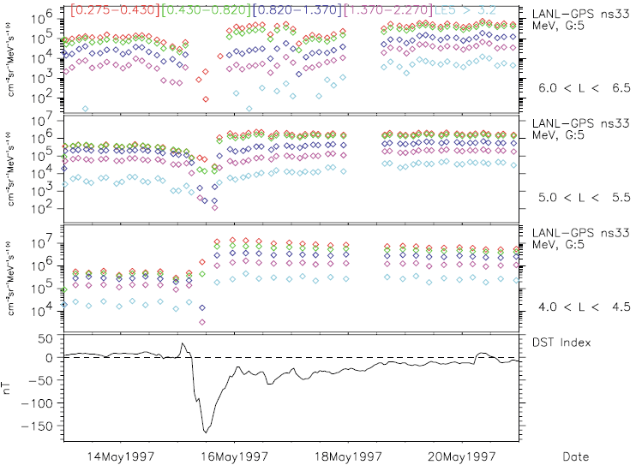
Energetic electron flux variation during storm
[Friedel et al.,2002]

Slide 42
Possible loss mechanisms
Name | Characteristics
Magnetopause shadowing [Desorgher et al., 2000] | Occur at larger L-shells
Outward adiabatic transport [Kim and Chan, 1997; Su et al., 2010b] | Dependent on magnetic field variation
Outward radial diffusion [Shprits et al., 2006] | Induced by outer boundary loss Associate with inward radial diffusion
Gyro-resonance with plume hiss and EMIC waves [e.g., Albert, 2003; Summers and Thorne, 2003; Thorne et al., 2005; Summers et al., 2007] | More effective for high energy (~MeV) electrons
Some observations [e.g., Morley et al., 2010] suggest that these mechanisms may be not enough to explain some very rapid dropout process.
There is only very limited progress on testing and quantifying the loss mechanisms in recent years.

Slide 43
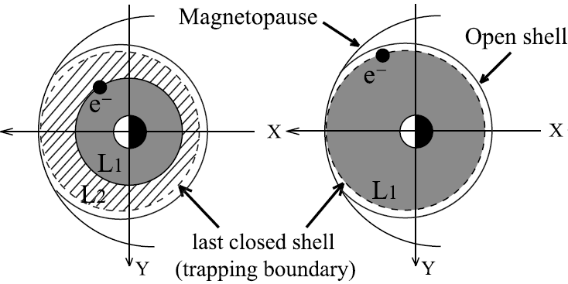
Magnetopause shadowing
[Kim et al., 2010]
Compression of magnetopause (MP)
Inflation of drift shell due to the buildup of ring current
Removal of high energy electrons out of MP

Slide 44
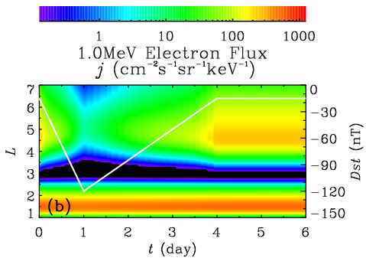
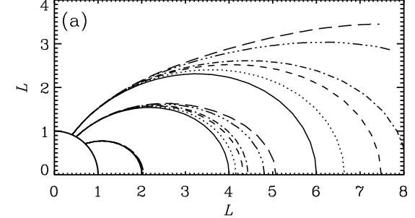

Adiabatic transport
Variation of magnetic field (ring current field)
[Su et al., 2010]
[Kim et al., 1997]
L1<L2 B1>B2 E1>E2

Slide 45

Geomagnetic storm 8/10/1990
Rapid dropout during main phase
Gradual buildup
during recovery phase

Slide 46
STEERB Model
Storm-Time Evolution of Electron Radiation Belt (STEERB) model [Su et al., 2010a, b, 2011a, b]
Three-dimensional modified Fokker-Planck equation
[Schulz and Lanzerotti , 1974]
Observable space
Adiabatic invariant space

Slide 47



Geomagnetic storm on 9 October 1990
Southward interplanetary magnetic field
Solar wind flow pressure
Kp index
Magnetopause location [Shue et al., 1998]
Plasmapause location [Carpenter and Anderson, 1992]
Dst index

Slide 48

CRRES observation

Slide 49


Inputs of STEERB
Interplanetary magnetic field
Solar wind flow pressure
Geomagnetic indices
Plume wave characteristics [Shprits et al. 2009]
Outer boundary condition
Initial condition
Independent of the observed electron flux

Slide 50

Outputs of STEERB
MS: Magnetopause Shadowing
AT: Adiabatic Transport
RD: Radial Diffusion
PW: Plume Waves
CW: Chorus Waves

Slide 51
Dropout simulation results
CRRES satellite provides a good representation of the radiation belt electron signatures from the prestorm (orbit 181) to minimum-Dst periods (orbit 186)
Different dropout characteristics at different L-shells
  In the region 6.0<L<7.0, significant (10-10³ times) depletions occurred at ~0.1--1.0 MeV electron fluxes
  In the region 4.3<L<6.0, large (10-10² times) depletions were restricted to the high energy (>0.4 MeV) electron fluxes.

Slide 52
Dropout simulation results
Various loss mechanisms are quantitatively tested based on the STEERB model
The competition and combination of several physical mechanisms (MS, AT, RD, PW and CW) can well explain the loss of radiation belt electrons, with the dominance of the first four physical processes.
Su, Z. P., Xiao, F. L., Zheng, H. N., and Wang, S., CRRES observation and STEERB simulation of the 9 October 1990 electron radiation belt dropout event, Geophys. Res. Lett., 38, L06106, 2011
Su, Z. P., Xiao, F. L., Zheng, H. N., and Wang, S., Radiation belt electron dynamics driven by adiabatic transport, radial diffusion, and wave-particle interactions, J. Geophys. Res., 116, A04205, 2011

Slide 53


Leading acceleration mechanism
Gyro-resonance with chorus waves
Inward radial diffusion

Slide 54

Recovery buildup simulation
Radial diff
Chorus
Both

Slide 55

Recovery buildup simulation
Radial diff
Chorus
Both

Slide 56
Buildup simulation results
Importance of local acceleration by chorus
3-D combination of radial diffusion and local accelerartion is essential
Either process alone does not give even rough quantitative agreement with the

Slide 57


Auroral Precipitation
Discrete auroras are the most intense auroral types where field-aligned acceleration play an important role.
Diffuse aurora are found on the equatorward part of auroral oval, in the region of the so-called central plasma sheet (CPS) precipitation most likely mapping to inner plasma sheet, where magnetic field is almost dipolar (see isotropic boundary).. diffuse aurora are relatively weak and difficult to observe on the Earth.

Slide 58


Introduction
Highly anisotropic electron pitch angle distributions (PADs)
  Peaked at 90 degree to the magnetic field,
  Near the magnetic equator from just outside plasmapause to beyond geostationary orbit
  From 50eV up to a few keV
  Called "pancakes" from their appearance in the velocity space
  Pancake index PI, defined as the flux ratio between the 90 deg to 70 deg, can achieve 10 at the geostationary orbit
[Wrenn et al.,1979]
[Sergienko et al.,2008]
Diffuse aurora
  Precipitation of keV electrons into atmosphere
  Resonant scattering by various waves
  An important sink of magnetospheric particles
  A primary high-latitude ionospheric energy source
  A strong magnetosphere-ionosphere coupling mechanism

Slide 59

Introduction
Following substorm injections, isotropic PAD can develop into pancake-shaped PAD
  Energy range 0.1-20keV
  Time scale several hours
  Position near the magnetic equator
  [Meredith et al., 1999,2000]
Associated wave characteristics
  Chorus wave
    Lower band (<0.5 gyro-frequency)—LBC
    Upper band (>0.5 gyro-frequency)---UBC
  Electron cyclotron harmonic (ECH) wave
  Statistical results:
    L>=6 resonant scattering by chorus
    L<6 resonant scattering by ECH and chorus
We shall present a numerical study to qualify the PAD evolution at L=6 due to interaction with whistler-mode chorus

Slide 60


Numerical Model
Basic Equation: 2D bounce-averaged Fokker-Planck equation
  equatorial pitch-angle
  electron momentum
  phase space density
  represent diffusion coefficients in pitch-angle, momentum and cross-pitch-angle-momentum, respectively
  auxiliary function
  is a quarter of bounce period in the loss cone, and infinity out of the loss cone
[Schulz and Lanzerotti 1974; Kozyra et al., 1994; Albert, 2004]
Numerical Method: Hybrid Finite Difference (HFD) method [Xiao et al., 2009]
Computational Range:

Slide 61






Numerical Model
Initial Condition: Kappa distribution
  Kappa Parameter:
  Characteristic energy:
Boundary Conditions
  Fixed boundary condition at the lower boundary
  Linear extrapolation at the upper boundary
  Equivalent extrapolation for the pitch-angle operator

Slide 62



Diffusion Coefficients
Wave Spectra Properties
Wave Normal Angle Distribution
where is the angle between the wave vector and the ambient magnetic field
Gyro-resonant Condition
Dispersion Relation

Slide 63




Diffusion Coefficients
Wave Amplitude
Wave Parameters
  LBC
  UBC
[Meredith et al.,2000]
The diffusion coefficients can be obtained following previous Work [Horne et al., 2005]

Slide 64


Diffusion Coefficients
The lower band chorus can only cause the precipitation loss of electrons with energies above 1keV by resonant scattering.
The upper band chorus can efficiently scatter electrons (0.1-2keV) into loss cone, and drive electrons with energies above 2keV toward loss cone

Slide 65

PAD Evolution
LBC Precipitation loss of electrons with energies above 1keV
UBC Precipitation loss of electrons with energies above 0.1-2.0keV
LBC+UBC Precipitation loss of electrons with energies above 0.1keV

Slide 66


PAD Evolution
Pancake

Slide 67

PAD Profiles-UB+LB
[Meredith et al.,1999]

Slide 68


Pancake Index-PI
[Meredith et al.,2000]
PI can increase from 1 to 6 in 5 hours due to combined interaction with upper and lower band chorus, consistent with the observation of Meredith et al., 2000.

Slide 69
Conclusion & Discussion
The bounce-averaged diffusion coefficients of pitch angle, momentum and cross-pitch-angle-momentum are calculated for upper and lower band chorus based on the observed wave characteristics. The upper band chorus can efficiently scatter electrons(0.1--2keV) into loss cone, and drive electrons with energies above 2~keV toward loss cone. The lower band chorus can only cause the precipitation loss of electrons with energies above 1keV by resonant scattering.
The obtained diffusion coefficients are used to solve the 2-D bounce-averaged Fokker-Planck equation to quantitatively study the PAD evolution of injected plasma sheet electrons due to interactions with upper-band chorus alone, lower band chorus alone, and both band chorus, respectively. The PADs of electrons with energies above0.1~keV can develop into the typical pancake-shaped distributions due to the combined resonant scattering by upper and lower band chorus.

Slide 70
Conclusion & Discussion
The PI can increase from 1 to 6 in 5hours due to combined interaction with upper and lower band chorus, consistent with the observation of Meredith et al., 2000, suggesting that the resonant scattering of electrons by the whistler-mode chorus waves be a substantial mechanism responsible for the formation of pancake distribution outside L=6.0.
The combined scattering by both band chorus can cause rapid precipitation of electrons with energies ~keV, which may be also responsible for diffuse aurora.

